Slide 1
Exact Greybody Factors for Brane Scalar Field of Five-dimensional Rotating Black Holes
The 3rd IBS-KIAS Joint Workshop at High 1 2019.02.14.
Yoonbai Kim
Sungkyunkwan University
In collaboration with
Young-Hwan Hyun, Seong Chan Park
arXiv:1901.10828

Slide 2
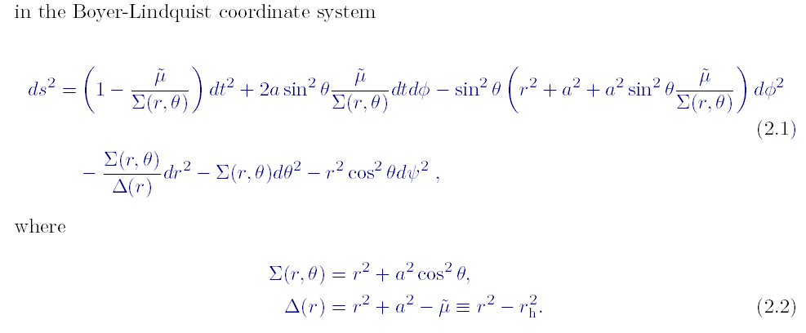
Myers-Perry Black Branes
(4+n)D
MP BH
5D Black hole: n=1
Single rotation parameter: dpsi=0
Charge is neglected.

Slide 3
What we are interested in among the high dimensional BH’s
In LHC,
→ Colliding partons
→ High gravitational effect in extradimension models
→ Mini Black Holes production & Bolding phase
→ Spin-down Phase (Hawking radiation) & BH decay
http://www.youtube.com/watch?v=cxqJHfTCzl0

Slide 4
Klein-Gordon equation
Klein-Gordon equation in curved spacetime background
Goal: exact solution

Slide 5
Generalized Teukolsky equation
Modes on the brane
Separation of variables
Solution

Slide 6
Generalized Teukolsky equation
Generalized Teukolsky equation
of the s=0 brane modes
obtained by using the induced four-dimensional metric
of the 5-dimensional rotating black hole

Slide 7
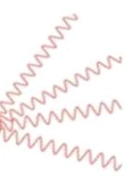
Solution of Teukolsky equation
(4+1)D
MP BH
Generalized Teukolsky eq. for brane fields
[Ida-Oda-SCP(2003)]
Exact solution?

Slide 8
Generalized Teukolsky equation
The wave equation of the s=0 brane modes
obtained by using the induced four-dimensional metric
of the (4+1)-dimensional rotating black hole
Spin-weighted Spheroidal Harmonics[Teukolsky(1973),IOP(2003)]
s=0, Spheroidal harmonics [Frolov (2003)]
????

Slide 9
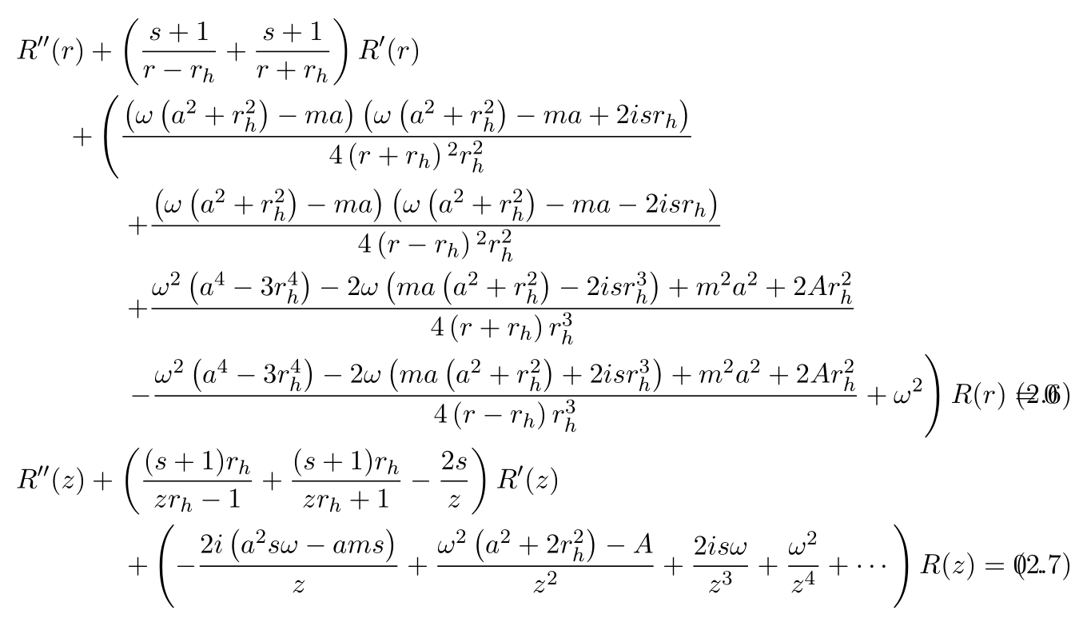
Confluent Heun equation
Confluent Heun Equation
For s=0, Spheroidal eq.

Slide 10
Full Solution
5D, s=0
MP BH

Slide 11
The Solution in terms of the radial spheroidal functions
5D, s=0
MP BH
Parameter range :

Slide 12
Researches for Hawking radiation
4D
(4+n)D
Kerr BH
MP BH
Generalized Teukolsky eq. for brane fields
[Ida-Oda-SCP, PRD67(2003)]
Teukolsky eq.
[S. Teukolsky(1972,1973)]
?
Sol. to Teukolsky eq.
[Teukolsky-Press, Starobinsky, Unruh, Page (1973-1976)]
[Leaver (1986), Sasaki(1994)]
Sol. to Gen. Teu. eq.
In the low energy limit
[Ida-Oda-SCP, PRD67(2003)]
?
Hawking radiation
[Hawking(1975), Page(1976)]
Hawking radiation
Numerical methods
[Ida-Oda-SCP (low ω,analytic)PRD67(2003)
(s=0)PRD71(2005), (s>0) PRD73(2006)]
[Duffy et al. (s=0) JHEP0509(2005)]
[Casals, et al (s=1)JHEP0602(2006) (s=1/2)JHEP0703(2007) (s=0)JHEP0806(2008)]

Slide 13
Analytical trials in the low-frequency limit
$$ω$$
High freq. limit
$$near horizon$$
$$far−field region$$
$$r$$
[Ida-Oda-SCP PRD67(2003)]
Matching method works
$Γ$($ω$)
Low freq. limit
Near horizon solution
Far field solution
Ingoing boundary condition

Slide 14
Analytical trials To 5D Radial Teu. Eq.
$$ω$$
High freq. limit
Full Solution
$$near horizon$$
$$far−field region$$
$$r$$
$Γ$($ω$)
Near horizon solution
Far field solution
Ingoing boundary condition

Slide 15
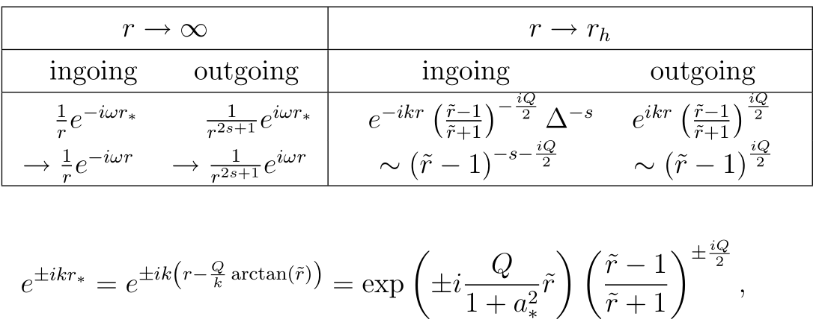
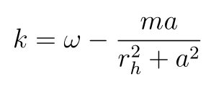
Asymptotic solutions and ingoing boundary condition
Ingoing boundary condition

Slide 16
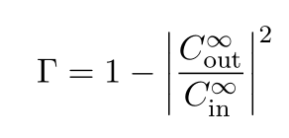
Greybody factor for brane scalar fields
(4+n)D, s=0
Ingoing boundary condition
MP BH
The absorption probability
of the incoming wave
Correction to black body radiation
(not black)

Slide 17
Greybody factor for brane scalar fields
MP BH

Slide 18
Consistent check with analytic results (In low frequency limit)
MP BH
Confirmed!

Slide 19
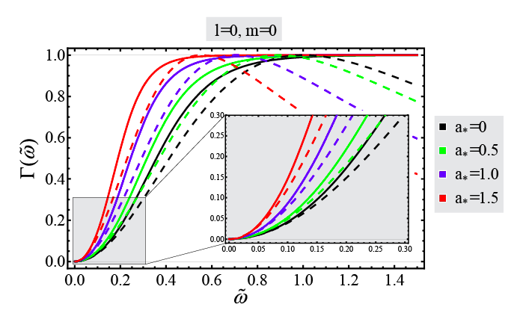
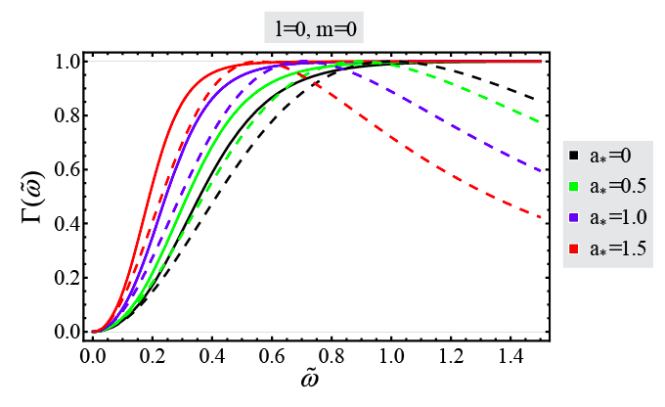
Consistent check with analytic results (In low frequency limit)

Slide 20
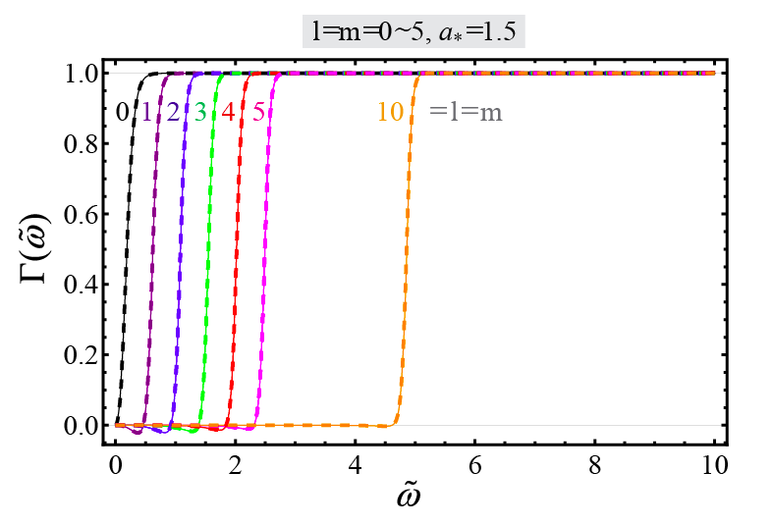
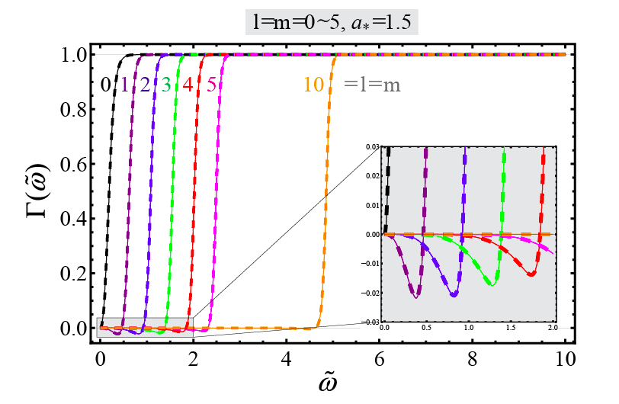
Consistent check with numerical results (In low frequency limit)

Slide 21
Conclusion
We found the full solution to the five-dimensional radial Teukolsky equation for brane scalar fields.
We derived the analytic form of the greybody factor for brane scalar fields in terms of the spheroidal joining factors.
We check the results with known analytic results in the low frequency limit.
We also check the results with numerical results.

