Slide 1
Local drive in interacting diffusive systems
(local pump, battery…)
David Mukamel
Tridib Sadhu, Satya Majumdar, DM PRE 84, 051136 (2011)
PRE 90, 012107 (2014)
Ydan Ben Dor, Yariv Kafri, DM, Ari M Turner PRL 128, 154501 (2022)
KIAS, July 24, 2024

Slide 2
Typically, driven systems show long-range correlations
in their steady state.
This is unlike systems in equilibrium where particles are
correlated only locally (except at a critical point).
Will discuss the effect of a local drive (a pump) in a
diffusive fluid on the steady state properties of the fluid.
In particular: how does a pump affect the steady state
at criticality where two mechanisms for long-range effects
are present.

Slide 3
Possible realizations
$2d$colloidal gas locally pumped by an optical tweezer
e.g. Roichman et al PRE 90, 042302 (2014)
From Tamir Admon, PhD thesis (TAU 2020)
Active systems where asymmetric objects placed in
the fluid act as local pumps.
Granek, Baek, Kafri, Solon JSTAT 063211 (2020)

Slide 4
Main results
The drive generates a non local density profile in the form of a
dipolar potential: $ϕ \left(r\right)−φ_{0}∝\frac{\vec{f}⋅\vec{r}}{r^{d}}$ in dimension $d.$
The density-density correlation is long ranged, decaying at large
distance as a quadrupolar potential in $2d$dimensions
$$C\left(r,s\right)=\left\langle φ_{r}φ_{s}\right\rangle −\left\langle φ_{r}\right\rangle \left\langle φ_{s}\right\rangle ∝\frac{1}{{\left(r^{2}+s^{2}\right)}^{d}}$$

Slide 5
We show that the density profile of the system with a pump is
the same as that of an equilibrium fluid in some particular external
potential.
local drive
external potential
$$v(r)$$
nonequilibrium
equilibrium
Same steady-state density profile

Slide 6
This correspondence allows one to analyze the density profile
even for a fluid at criticality.
At criticality the density profile can be expressed in terms of the
equilibrium critical exponents of the fluid.
Interesting crossover to a different behavior takes place at
$r≈ξ$ in $d=2,3$dimensions.

Slide 7
In particular at criticality and at large distances $r≫ξ$
$$\left\langle φ(r)\right\rangle −φ_{0}∝{\left(\frac{\vec{f}⋅\vec{r}}{r^{d}}\right)}^{1/δ}$$
$δ=15$ ,$4.79 (d=2,3)$
In $d=2,3$there is a crossover to a different behavior at short
distance $r≪ξ$
$$\left\langle φ(r)\right\rangle −φ_{0}∝\frac{\vec{f}⋅\vec{r}}{r^{d−2+η}}$$
$$\frac{\vec{f}⋅ \vec{r}}{r^{d−2+η}}$$
$${\left|\frac{\vec{f}⋅ \vec{r}}{r^{d}}\right|}^{\frac{1}{δ}}$$
$$0$$
$$r^{∗}$$

Slide 8
The steady state current profile is independent of temperature
and it has the form of dipolar electric field above, at and below
criticality.
$$j\left(\vec{r}\right)=\frac{q}{2π}\frac{1}{r^{d}}[{\vec{e}}_{1}−\frac{d\left({\vec{e}}_{1}\vec{r}\right)\vec{r}}{r^{2}}]+O(\frac{1}{r^{3}})$$

Slide 9
Outline
Local drive in exclusion model (SSEP)
Use the exclusion model to calculate the large distance
density correlation induced by the drive.
Apply model B dynamics to calculate the density profile at
arbitrary temperature, in particular at criticality.

Slide 10
Lattice gas model (SSEP)
Particles diffusing on a grid (with exclusion)
occupation number $τ_{i}=0,1$
1
N particles
V sites
$$φ_{i}=\left\langle τ_{i}\right\rangle$$
$$∂_{t}φ\left(\vec{r}, t\right)=∇^{2}φ\left(\vec{r}, t\right)$$
in the steady state
$$φ\left(\vec{r}\right)=N/V$$

Slide 11
Effect of a local drive: a single driving bond
1
1
1
1
$$1−ε$$
0
1
$$1+ε$$

Slide 12
The resulting dynamical equations: non-interacting particles
$$τ_{i}=0,1$$
$$1−ε$$
$$φ_{i}\left(t\right)=\left\langle τ_{i}(t)\right\rangle$$
0
1
$$1+ε$$
$$∂_{t}φ\left(\vec{r}, t\right)=∇^{2}φ\left(\vec{r}, t\right)+ε(φ_{0}+φ_{1})[δ_{\vec{r},\vec{0}}−δ_{\vec{r},\vec{e_{1}}}]$$

Slide 13
In the steady state (e.g. in $2d)$
$$∇^{2}φ\left(\vec{r}, t\right)=q[δ_{\vec{r},\vec{0}}−δ_{\vec{r},\vec{e_{1}}}]$$
with
$$q=−ε(φ_{0}+φ_{1})$$
where by symmetry:
$$q=−2ε\overline{φ}$$
Thus
$$φ\left(\vec{r}\right)=\overline{φ}−\frac{q}{2π}\frac{{\vec{e}}_{1}\vec{r}}{r^{2}}+O(\frac{1}{r^{2}})$$
dipolar potential

Slide 14
The resulting dynamical equations: with exclusion
$$τ_{i}=0,1$$
$$1−ε$$
$$φ_{i}\left(t\right)=\left\langle τ_{i}(t)\right\rangle$$
0
1
$$1+ε$$
$$∂_{t}φ\left(\vec{r}, t\right)=∇^{2}φ\left(\vec{r}, t\right)+ε(φ_{0}+φ_{1}−2\left\langle τ_{0}τ_{1}\right\rangle )[δ_{\vec{r},\vec{0}}−δ_{\vec{r},\vec{e_{1}}}]$$

Slide 15
In the steady state (e.g. in $2d)$
$$∇^{2}φ\left(\vec{r}, t\right)=q[δ_{\vec{r},\vec{0}}−δ_{\vec{r},\vec{e_{1}}}]$$
with
$$q=−ε(φ_{0}+φ_{1}−2\left\langle τ_{0}τ_{1}\right\rangle )$$
and thus
$$φ\left(\vec{r}\right)=φ_{0}−\frac{q}{2π}\frac{{\vec{e}}_{1}\vec{r}}{r^{2}}+O(\frac{1}{r^{2}})$$
dipolar potential
Note: the dipole strength involves the correlation $\left\langle τ_{0}τ_{1}\right\rangle .$
It may be calculated perturbatively in small $ε$
which to leading order $q=2 ε\overline{φ} (1−\overline{φ})$

Slide 16
The current
$$j(\vec{r})∝∇φ(\vec{r})$$
$$j\left(\vec{r}\right)=\frac{q}{2π}\frac{1}{r^{2}}[{\vec{e}}_{1}−\frac{2\left({\vec{e}}_{1}\vec{r}\right)\vec{r}}{r^{2}}]+O(\frac{1}{r^{3}})$$
dipolar electric field

Slide 17
Simulation results
Simulation on a $200×200$ lattice with $ρ=0.6$
For the interacting case the strength of the dipole was measured separately .

Slide 18
Two-point correlation function
$C\left(r,s\right)=<τ\left(r\right)τ\left(s\right)>$- $φ$(r) $φ(s)$
In d=1 dimension, in the hydrodynamic limit
$C_{L}\left(i,j\right)=\frac{1}{L}$g($\frac{i}{L}$ , $\frac{j}{L}$)
$$φ$$
T. Bodineau, B. Derrida, J.L. Lebowitz, JSP, 140 648 (2010).

Slide 19
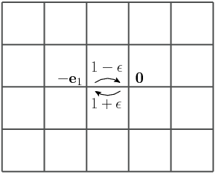
In higher dimensions local currents do not vanish for large
L and the correlation function does not vanish in this limit.

Slide 20
Steady state
$C\left(r,s\right)=<τ\left(r\right)τ\left(s\right)>$- $φ$(r) $φ(s)$
For $r≠s, s±1$
$$\frac{∂C(r,s)}{∂t}=Δ_{r}C\left(r,s\right)+Δ_{s}C(r,s)$$
$C(r,s)$ corresponds to an electrostatic potential in $2d$induced by $σ$
$$\left(Δ_{r}+Δ_{s}\right)C\left(r,s\right)=σ_{}\left(r,s\right)$$

Slide 21
$$\left(Δ_{r}+Δ_{s}\right)C\left(r,s\right)=σ_{1}\left(r,s\right)+σ_{2}\left(r,s\right)+σ_{3}(r,s)$$

Slide 22
The charge distribution can be shown to have the form
of a local quadrupole (either using particle hole symmetry
at density $\left\langle φ\right\rangle =0.5$or to second order in the drive $ε$otherwise.
$$C(r,s)\sim 1/{\left(r^{2}+s^{2}\right)}^{d}$$
quadrupole potential in $2d$ dimensions

Slide 23
Local pump in an interacting fluid at arbitrary temperature
Model B dynamics
$$F_{0}=\int{d^{d}r\left[\frac{K}{2}{\left(∇φ\right)}^{2}+\frac{τ}{2}φ^{2}+\frac{u}{4}φ^{4}\right]}$$
Model B dynamics: conserving density
Chemical potential:
$$μ_{0}(r)=\frac{δF_{0}}{δφ(r)}$$
$$J_{0}=−M∇μ_{0}$$
$$M −mobility$$
$$J=J_{0}+M\vec{f}δ^{d}\left(r\right)+ξ$$
$ξ$ - noise
$$\frac{∂φ}{∂t}=−∇J$$

Slide 24
Averaging over the noise:
$$\left\langle J\right\rangle =\left\langle J_{0}\right\rangle +M\vec{f}δ^{d}\left(r\right)$$
$$\left\langle J_{0}\right\rangle =−M∇\left\langle μ_{0}\right\rangle$$
$$\frac{∂\left\langle φ\right\rangle }{∂t}=M∇^{2}\left\langle μ_{0}\right\rangle −M∇\left(\vec{f}δ^{d}\left(r\right)\right)$$
In the steady state:
$$∇^{2}\left\langle μ_{0}\right\rangle =∇\left(\vec{f}δ^{d}\left(r\right)\right)$$
$\left\langle μ_{0}\right\rangle$ is thus a potential of an electric dipole
$$\left\langle μ_{0}\right\rangle =\frac{1}{S_{d}}\frac{\vec{f}⋅ \vec{r}}{r^{d}}$$

Slide 25
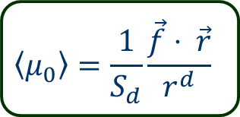
The current
$$\left\langle J_{0}\right\rangle =−M∇\left\langle μ_{0}\right\rangle = \frac{M}{S_{d}}\left[\frac{d\left(\vec{f}⋅ \vec{r}\right) \vec{r}}{r^{2}}− \vec{f}\right]\frac{1}{r^{d}}$$
dipolar electric field
$$\left\langle J\right\rangle =\left\langle J_{0}\right\rangle +M\vec{f}δ^{d}\left(r\right)$$
The form of the current is thus independent of the temperature
and its amplitude decays as $1/r^{d}$ at large distance.

Slide 26
Steady state density profile
$$∇^{2}\left\langle μ_{0}\right\rangle =∇\left(\vec{f}δ^{d}\left(r\right)\right)$$
It is instructive to note that this equation can be derived as
the equilibrium steady state of a model with an ordering field
$$h\left(r\right)=\frac{1}{S_{d}}\frac{\vec{f}⋅ \vec{r}}{r^{d}}$$
$$h(r)$$
Nonequilibrium local drive $\vec{f}δ^{d}\left(r\right)$
Equilibrium with a field $h=\frac{1}{S_{d}}\frac{\vec{f}⋅ \vec{r}}{r^{d}}$
$$H=−J\sum_{\left\langle i,j\right\rangle }{s_{i}s_{j}}−\sum_{i}{h_{i}s_{i}}$$

Slide 27
This representation has tremendous advantage
One can use whatever is known on equilibrium steady state
to study the locally driven system.
Great numerical advantage since in equilibrium the steady
state is independent of the dynamics, and more efficient dynamics
e.g. cluster Wolff algorithm may be applied for its analysis.
This is particularly useful at criticality where local dynamics is slow.

Slide 28
The equivalence between the two problems can be seen as follows:
$$∇^{2}\left\langle μ_{0}\right\rangle =∇\left(\vec{f}δ^{d}\left(r\right)\right)$$
$$\left\langle μ_{0}\right\rangle =−K∇^{2}\left\langle φ\right\rangle +τ\left\langle φ\right\rangle +u\left\langle φ^{3}\right\rangle$$
Helmholtz decomposition
$\vec{f}δ^{d}\left(r\right)=∇h+\vec{v}$
$h$- scalar field and $∇\vec{v}=0$
Thus
$$∇^{2}h\left(r\right) =∇\left(\vec{f}δ^{d}\left(r\right)\right)$$
$h\left(r\right)$ is a dipolar potential
$$h\left(r\right)=\frac{1}{S_{d}}\frac{\vec{f}⋅ \vec{r}}{r^{d}}$$
Resulting in:

Slide 29
Thus the steady-state equation
$$∇^{2}\left\langle μ_{0}\right\rangle =∇\left(\vec{f}δ^{d}\left(r\right)\right)$$
can be written as:
$$h\left(r\right)=\frac{1}{S_{d}}\frac{\vec{f}⋅ \vec{r}}{r^{d}}$$
$$∇^{2}\left\langle μ_{0}\right\rangle −∇^{2}h\left(r\right)=0$$
with
This is the steady state equation of a system at equilibrium
with free energy
$$F=F_{0}−\int{d^{d}rh\left(r\right)φ(r)}$$

Slide 30
$$F=F_{0}−\int{d^{d}rh\left(r\right)φ(r)}$$
$$μ=\frac{δF(φ\left(r\right))}{δφ}=μ_{0}−h(r)$$
$$J=−∇μ$$
In the steady state
$\frac{∂φ}{∂t}=−∇J=∇^{2}μ=0$
$$∇^{2}\left\langle μ_{0}\right\rangle −∇^{2}h\left(r\right)=0$$
$$μ=\frac{δF(φ\left(r\right))}{δφ}=μ_{0}−h(r)$$
The steady state is independent of the dynamics.
One can thus apply faster non-conserving dynamics or
cluster algorithms to study it.

Slide 31
$$h(r)$$
Nonequilibrium local drive $\vec{f}δ^{d}\left(r\right)$
Equilibrium with a field $h=\frac{1}{S_{d}}\frac{\vec{f}⋅ \vec{r}}{r^{d}}$

Slide 32
Steady state profile
$$−K∇^{2}\left\langle φ\right\rangle +τ\left\langle φ\right\rangle +u\left\langle φ^{3}\right\rangle −h\left(r\right)=0$$
$$h\left(r\right)=\frac{1}{S_{d}}\frac{\vec{f}⋅ \vec{r}}{r^{d}}$$
Paramagnetic phase $(τ>0)$:
The $K$and $u$ terms may be neglected
$$\left\langle φ(r)\right\rangle =\frac{1}{{τS}_{d}}\frac{\vec{f}⋅ \vec{r}}{r^{d}}$$
dipolar potential as found for the hard core gas.

Slide 33
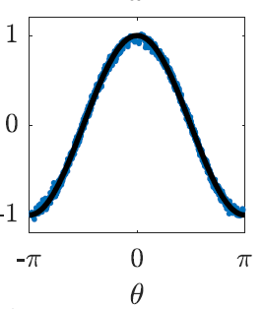
$$T=2T_{c}$$
$$cos⁡(θ)$$
$$L=512, r=0.35L$$

Slide 34
At criticality $\left(τ=0\right):$
$$ξ\left(h\right)=h^{−\frac{δ−1}{δ(2−η)}}$$
$$h\left(r\right)=\frac{1}{S_{d}}\frac{\vec{f}⋅ \vec{r}}{r^{d}}$$
The field $h\left(r\right)$ takes the system off criticality
$$h(r)$$
$$ξ(r)$$
$$r$$
There are two regimes: $ξ≪r$and $ξ≫r$

Slide 35
$$h(r)$$
For $ξ≪r$
$$ξ(r)$$
$$r$$
$h\left(r\right)$is basically constant on a length scale $ξ$around $r$
$$h\left(r\right)=\frac{1}{S_{d}}\frac{\vec{f}⋅ \vec{r}}{r^{d}}$$
$$φ(r)∝{\left|\frac{\vec{f}⋅ \vec{r}}{r^{d}}\right|}^{\frac{1}{δ}}sgn(\vec{f}⋅ \vec{r})$$

Slide 36
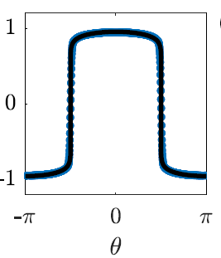
Angular dependence of the density in $2d$
$$T=2T_{c}$$
$$T=T_{c}$$
$$cos⁡(θ)$$
$${\cos\left(θ\right)}^{1/15}$$
$$L=512, r=0.35L>r^{∗}$$

Slide 37
$$ξ≫r$$
Linear response:
$$\left\langle φ(r)\right\rangle =\int{d^{d}r^{′}G\left(r−r^{′}\right)h(r′)}$$
$$G\left(r\right)∝\frac{1}{r^{d−2+η}}$$
$$h\left(r\right)=\frac{1}{S_{d}}\frac{\vec{f}⋅ \vec{r}}{r^{d}}$$
with
and
$$\left\langle φ(r)\right\rangle ∝\frac{\vec{f}⋅ \vec{r}}{r^{d−2+η}}$$

Slide 38
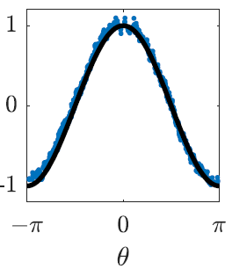
$$T=2T_{c}$$
$$T=T_{c}$$
$$cos⁡(θ)$$
$$cos⁡(θ)$$
$$L=512, r=0.35L<r^{∗}$$

Slide 39
Crossover distance $r^{∗}$
$$ξ\left(h\right)=h^{−\frac{δ−1}{δ(2−η)}}$$
$$h\left(r\right)=\frac{1}{S_{d}}\frac{\vec{f}⋅ \vec{r}}{r^{d}}$$
$$r^{∗}={\left(\frac{f}{r^{∗(d−1)}}\right)}^{−\frac{δ−1}{δ(2−η)}}$$
$$s=−\frac{δ+1}{δ+1−d}$$
Thus
$$r^{∗}∝f^{s}$$
$$s=−\frac{8}{7} \left(d=2\right) s=−2.08 (d=3)$$
$s<0$for $d=2,3$ and hence $r^{∗}$ diverges at small $f$

Slide 40
$$\frac{\vec{f}⋅ \vec{r}}{r^{d−2+η}}$$
$${\left|\frac{\vec{f}⋅ \vec{r}}{r^{d}}\right|}^{\frac{1}{δ}}$$
$$0$$
$$r^{∗}$$
$$d=2 δ=15 η=0.25$$
$$d=3 δ= 4.79 η=.036$$
$$r^{∗}∝f^{s}$$
Note: in $d=2$the density increases with $r$in the linear regime

Slide 41
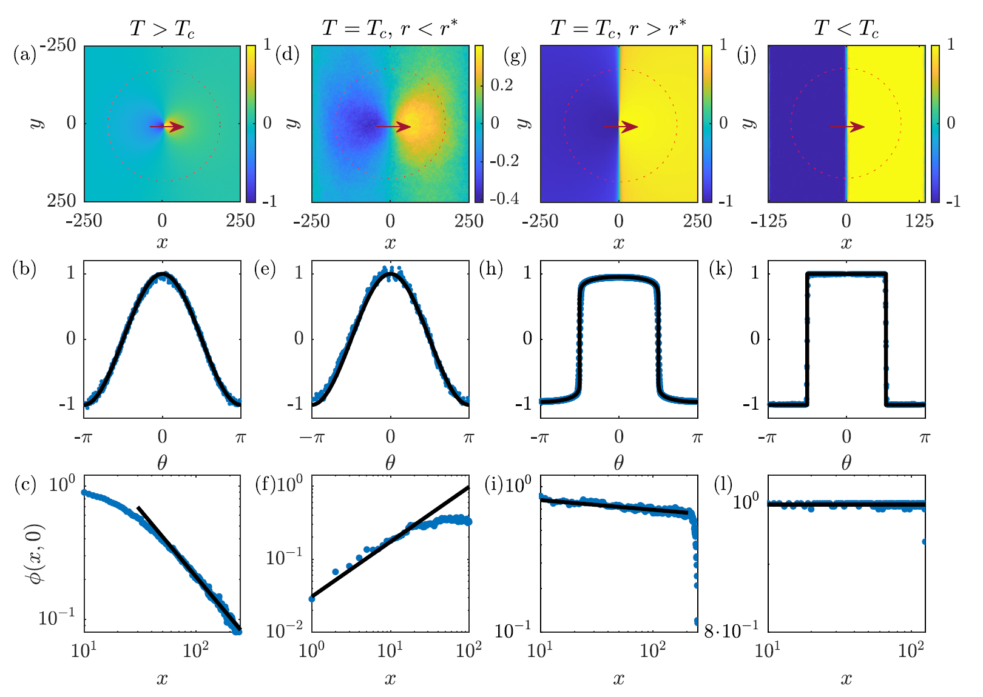
$$T=2T_{c}$$
$$T=0.5T_{c}$$
$$r=0.35L$$
f=1
f=0.03
f=100
$2d$density plots

Slide 42
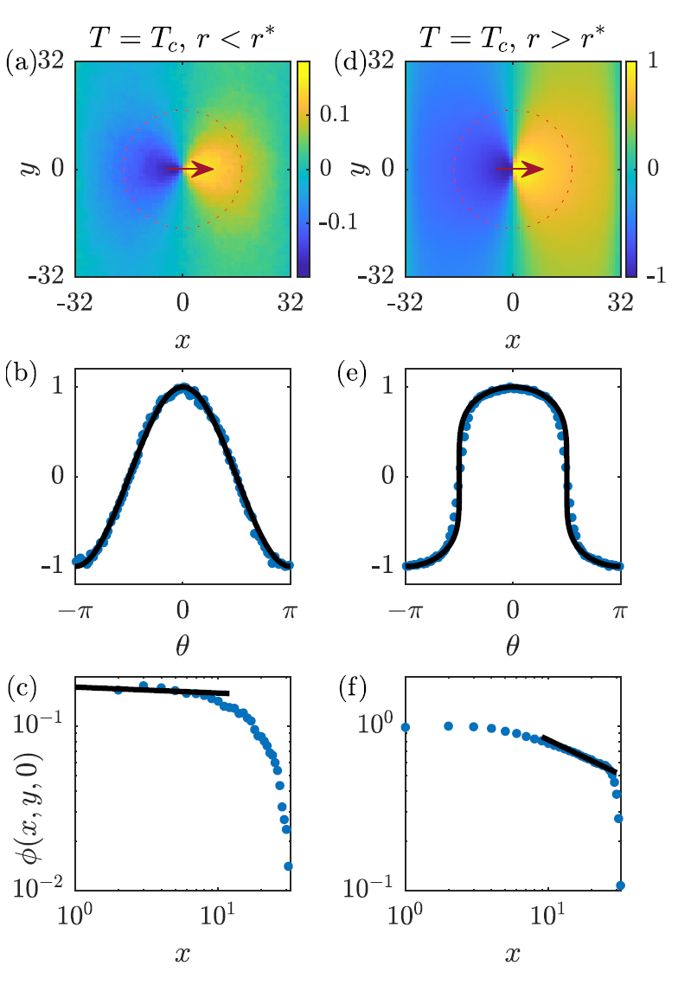
Profiles in $z=0$plane
Angular dependence at $r=.28L$
$$cosθ$$
$$(cos⁡{θ)}^{2.09}$$
Radial dependence along the
pump
Density plots in 3d L=64.

Slide 43
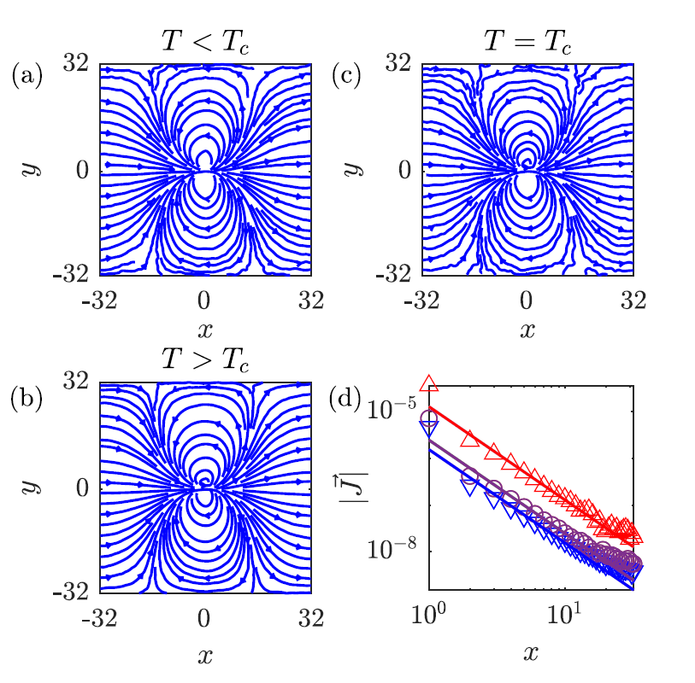
$$T=0.9T_{c}$$
$$T=2T_{c}$$
$$J\sim \frac{1}{r^{2}}$$
at all $T$
Current streamlines and decay in $2d, L=64$

Slide 44
Summary
Local drive in a fluid generates a non local density profile in the form
of a dipolar potential: $ϕ \left(r\right)−φ_{0}∝\frac{\vec{f}⋅\vec{r}}{r^{d}}$ in dimension $d$
The density-density correlation is long ranged, decaying at large
distance as a quadrupolar potential in $2d$dimensions
$$C\left(r,s\right)=\left\langle φ_{r}φ_{s}\right\rangle −\left\langle φ_{r}\right\rangle \left\langle φ_{s}\right\rangle ∝\frac{1}{{\left(r^{2}+s^{2}\right)}^{d}}$$
The density profile of the locally driven system is equivalent to that of equilibrium non-driven system in a dipolar field.
As a result the non-equilibrium density profile can be expressed in
terms of the equilibrium critical exponent of the fluid.

