Slide 1
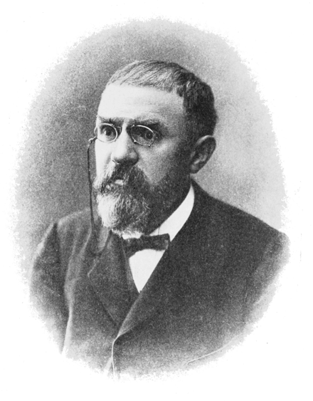
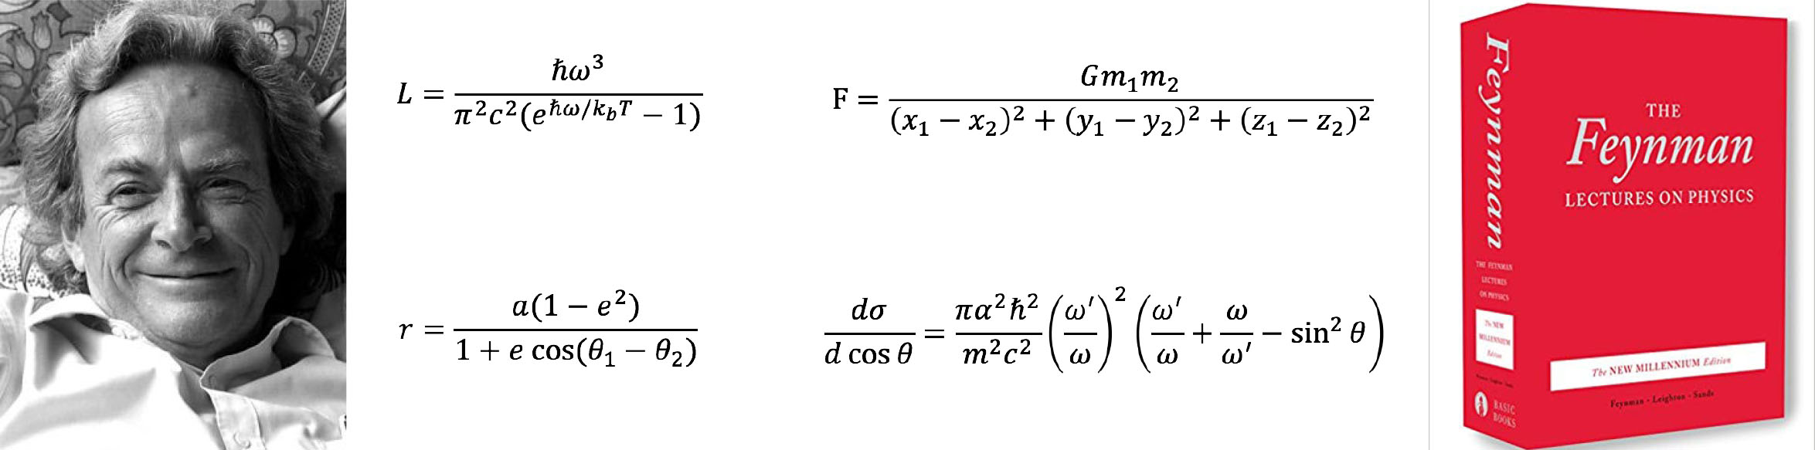
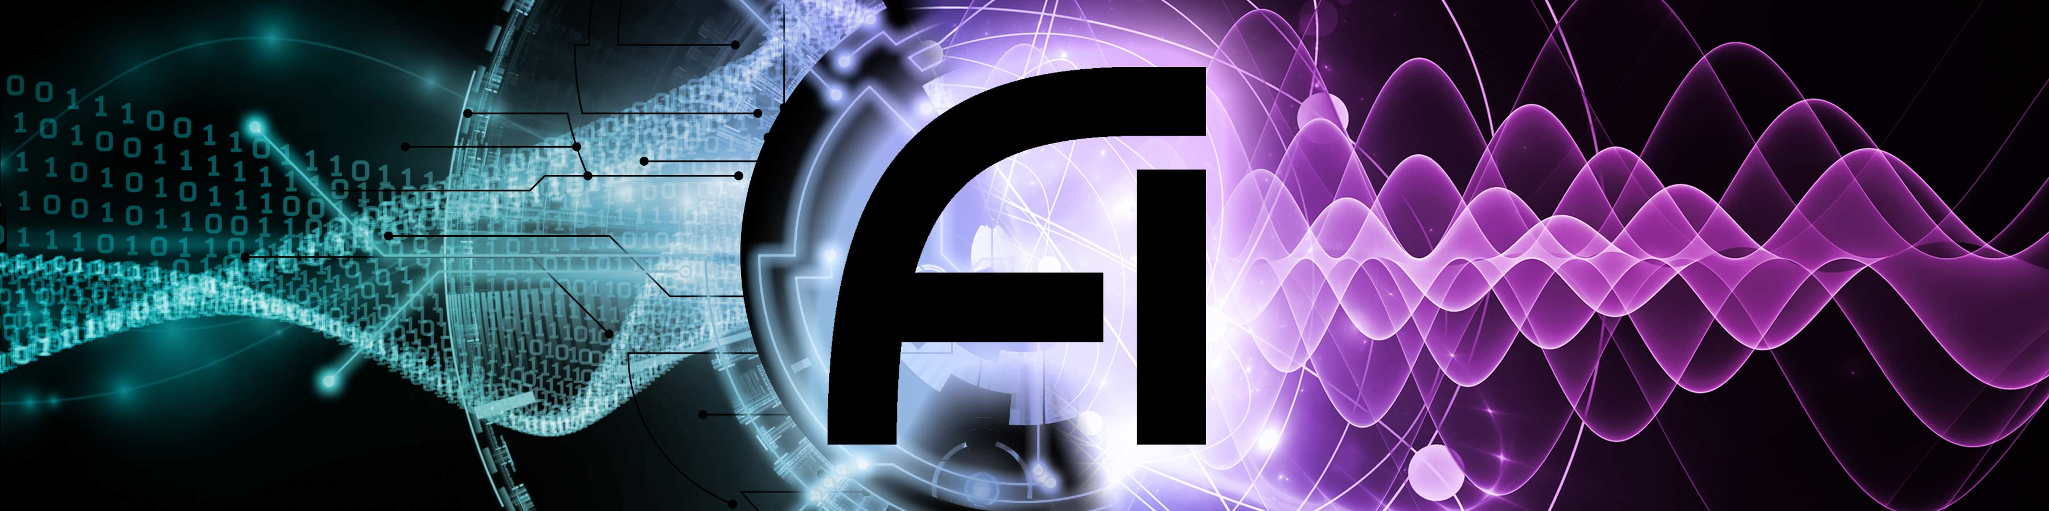




Extracting learned knowledge from a black box
Max Tegmark
Institute for Artificial Intelligence
and Fundamental Interactions
Notes:
Abstract: A central goal of physics is to discover mathematical patterns in data. For example, after four years of analyzing data tables on planetary orbits, Johannes Kepler started a scientific revolution in 1605 by discovering that Mars' orbit was an ellipse. I describe how we can automate such tasks with machine learning and not only discover symbolic formulas accurately matching datasets (so-called symbolic regression), equations of motion and conserved quantities, but also auto-discover which degrees of freedom are most useful for predicting time evolution (for example, optimal generalized coordinates extracted from video data). The methods I present exploit numerous ideas from physics to recursively simplify neural networks, ranging from symmetries to differentiable manifolds, curvature and topological defects, and also take advantage of mathematical insights from knot theory and graph modularity.

Slide 2
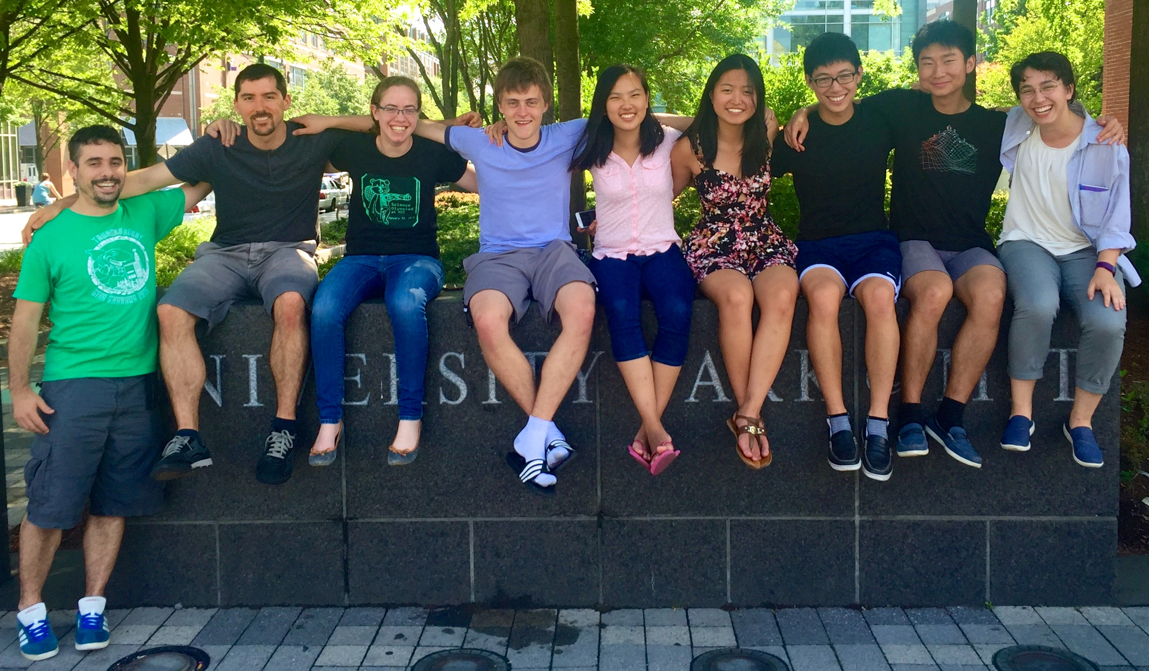
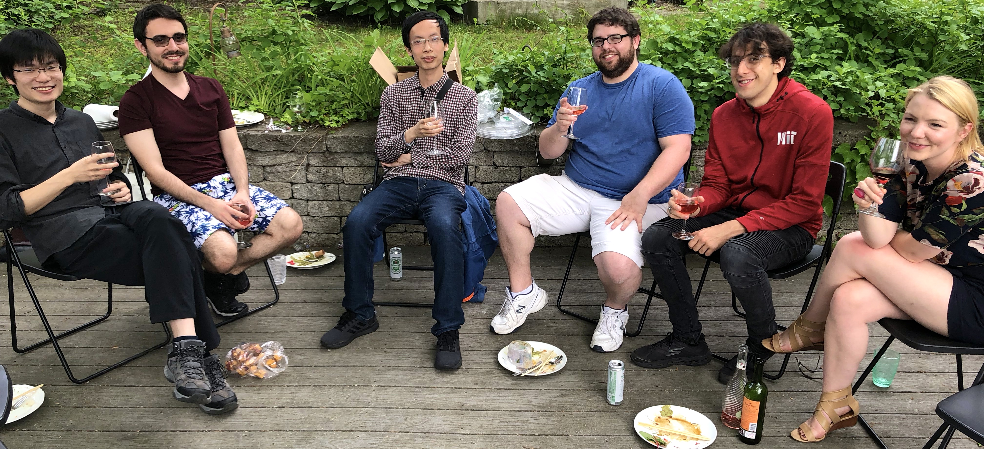
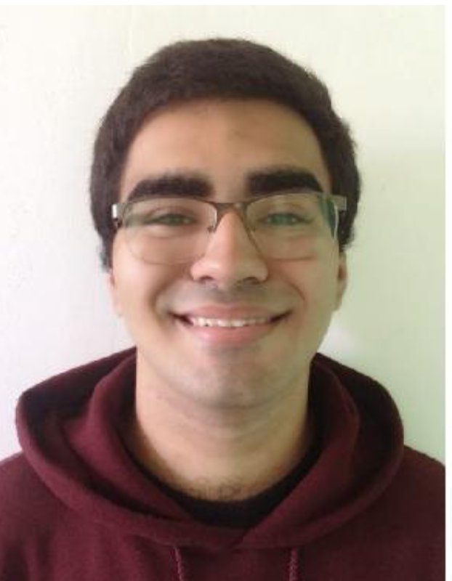
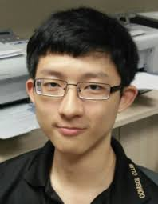
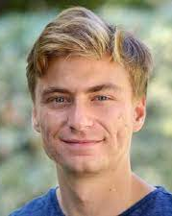

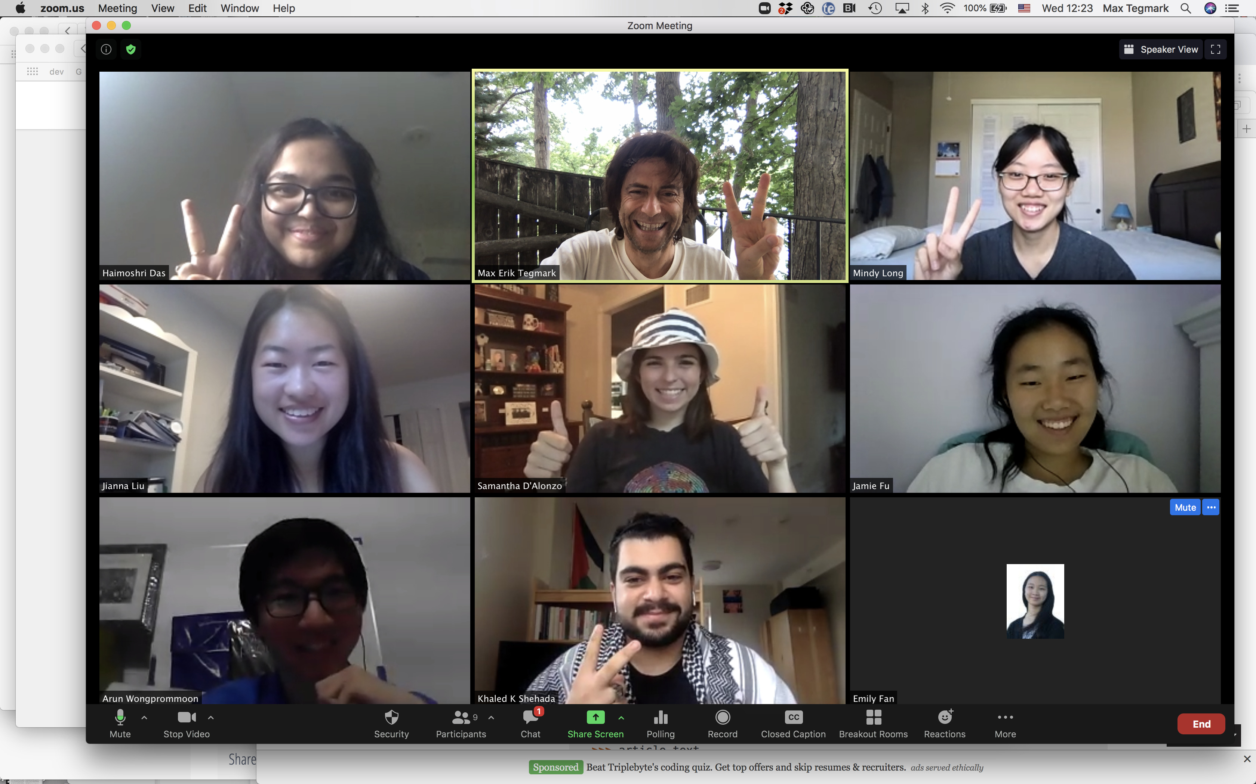

Extracting learned knowledge from a black box
Welcome to MIT!
Jianna Liu
Mindy Long
Arun Wongprommon
Jamie Fu
Khaled Shehada
YOU?
Emily Fan
Samantha D'Alonzo
Haimoshri Das

Slide 3
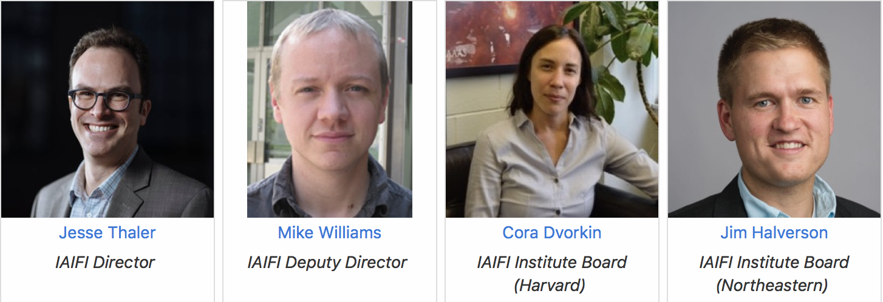
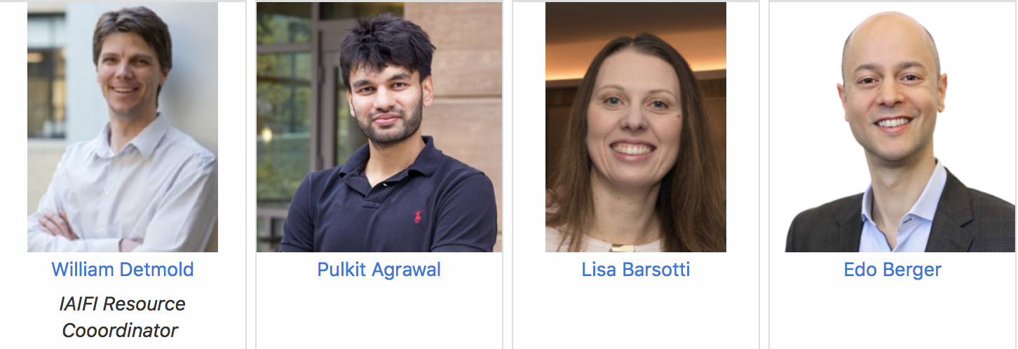
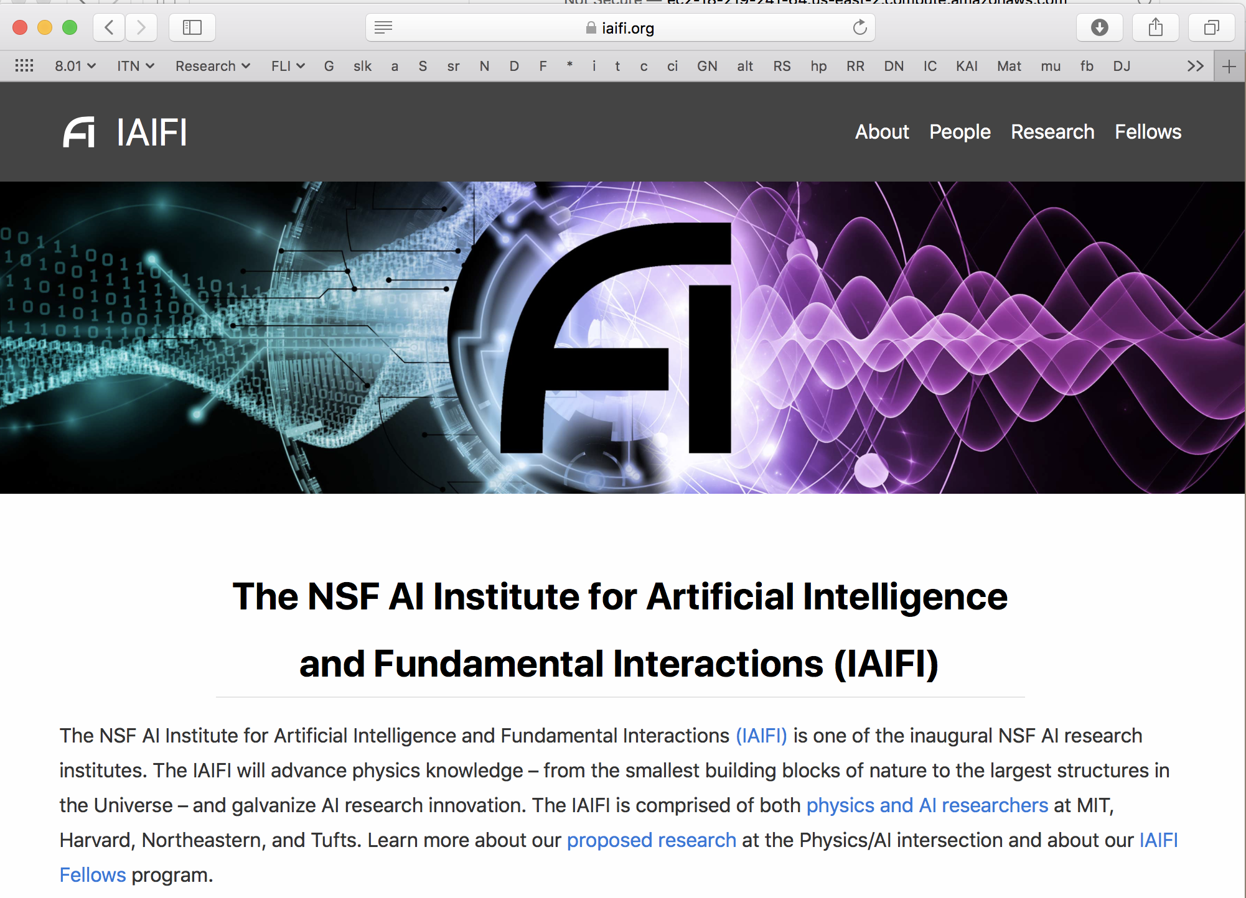
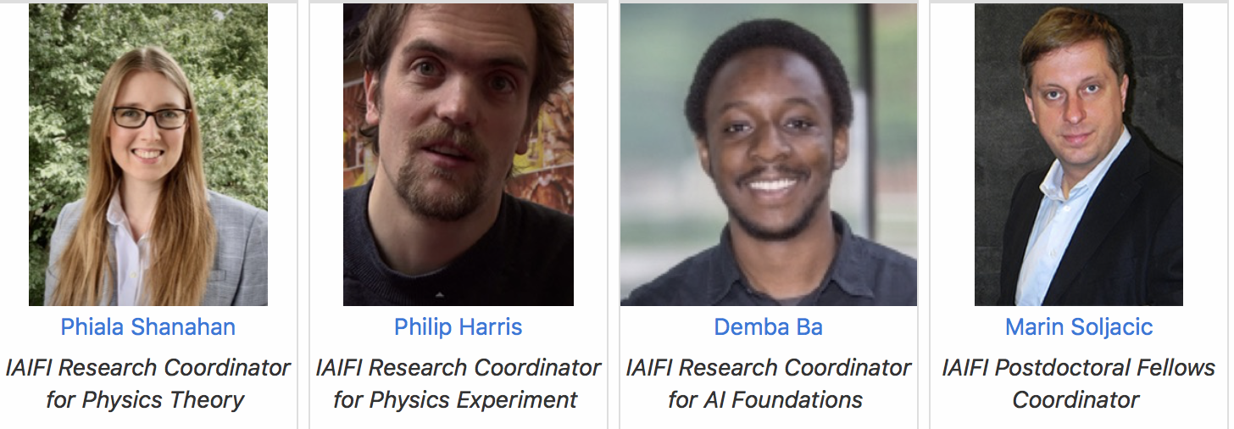
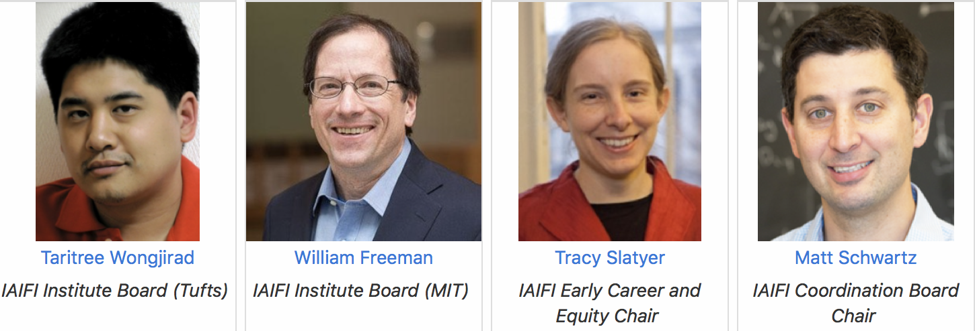
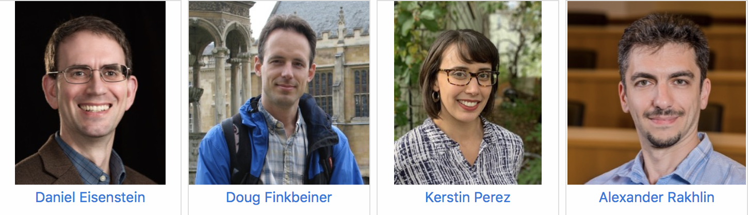
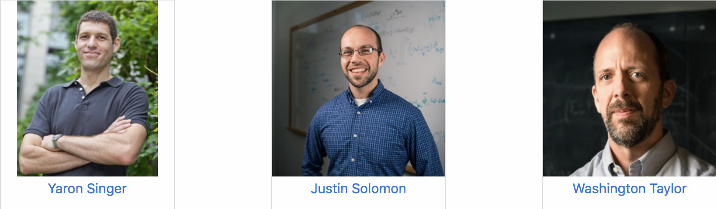

AI + physics = IAIFI
IAIFI.org
Welcome to MIT!
YOU?

Slide 4
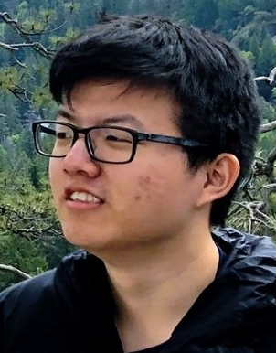
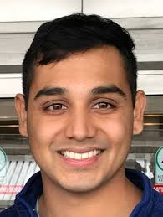

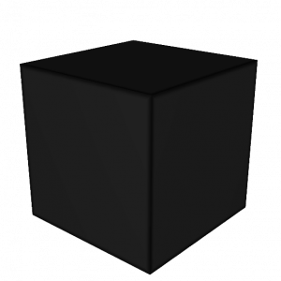
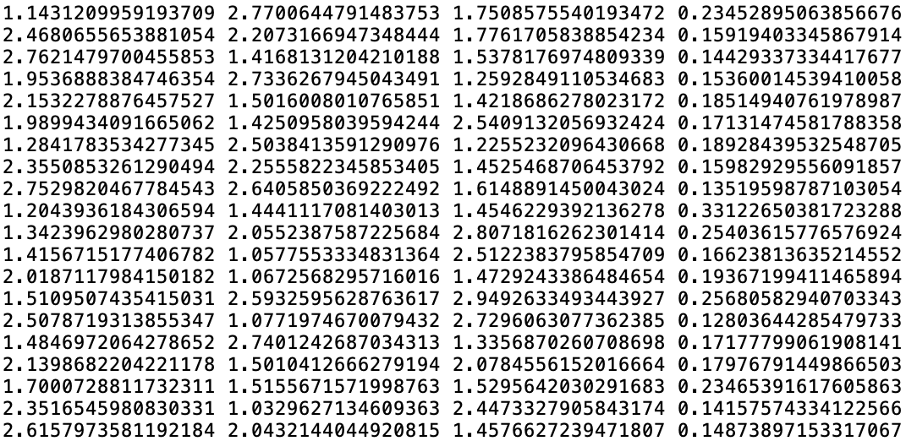
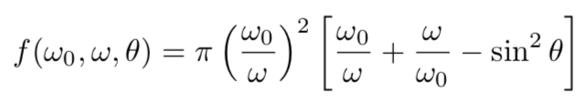
Beyond the black box
Data
Inscrutable
black box model
Model we can
understand
Train
neural
network
Extract
learned
knowledge

Slide 5
Beyond the black box
Data
Inscrutable
black box model
Model we can
understand
Train
neural
network
Extract
learned
knowledge
Today I'll focus on auto-discovery of
representations
equations (symbolic regression)
manifolds
useful degrees of freedom ("pregression")
conserved quantities

Slide 6
Representation
learning
Notes:
Just won CASP13 competition

Slide 7
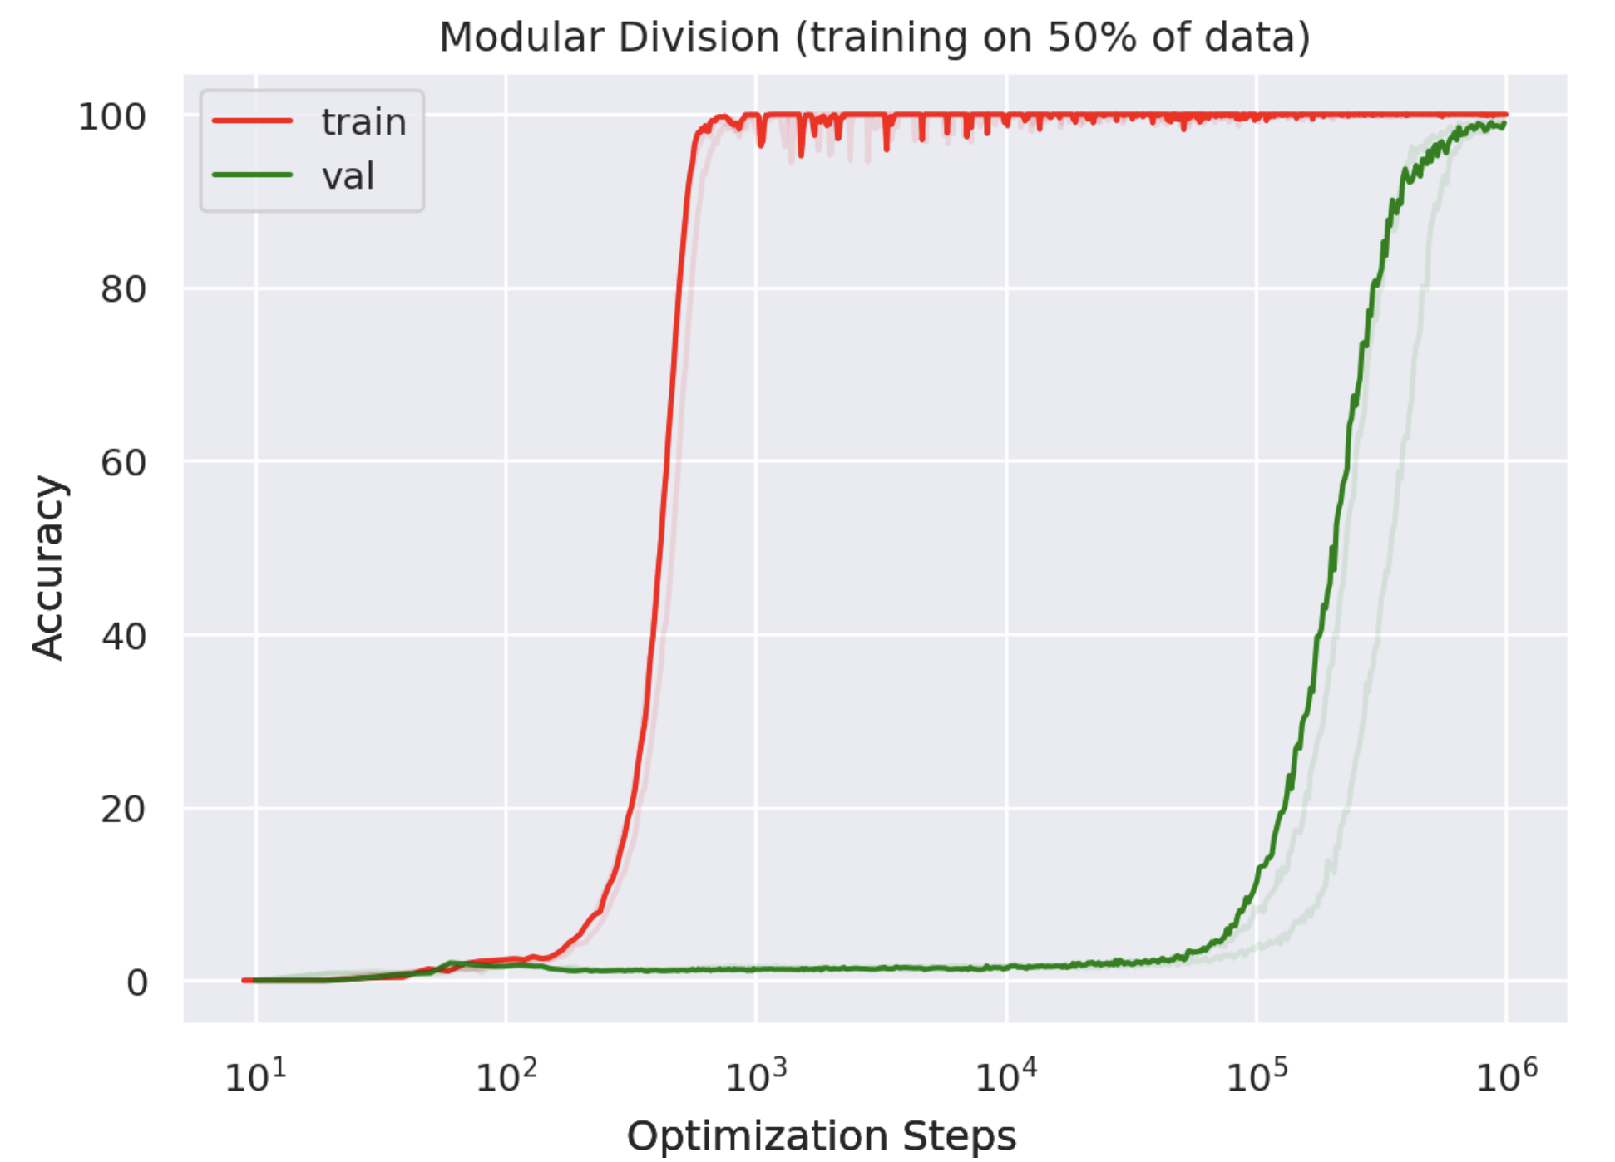
Memorization
Grokking
Confusion
Alathea power et al (Open AI):
https://arxiv.org/abs/2201.02177
Notes:
Looks like a phase transitions!

Slide 8
Numerical experiment: learn group operation on abstract symbols
Image of
symbol
Group
operation
Image of
symbol
Image of
symbol
https://arxiv.org/abs/2205.10343
Notes:
Symbolic regression is finding a symbolic formula fitting a data table.

Slide 9
Numerical experiment: learn group operation on abstract symbols
3
Image of
symbol
Group
operation
Example: addition mod 59
Image of
symbol
Image of
symbol
12
50
https://arxiv.org/abs/2205.10343
Notes:
Symbolic regression is finding a symbolic formula fitting a data table.

Slide 10
Numerical experiment: learn group operation on abstract symbols
3
Image of
symbol
Decoder
Matrix
multi-
plication
Encoder
Encoder
Image of
symbol
Image of
symbol
12
50
https://arxiv.org/abs/2205.10343
Notes:
Symbolic regression is finding a symbolic formula fitting a data table.

Slide 11
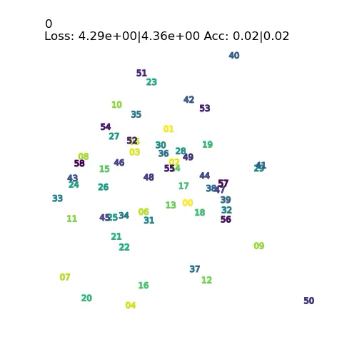
Numerical experiment: learn group operation on abstract symbols
Image of
symbol
Decoder
Matrix
multi-
plication
Encoder
Encoder
Image of
symbol
Image of
symbol
https://arxiv.org/abs/2205.10343
Notes:
Symbolic regression is finding a symbolic formula fitting a data table.

Slide 12
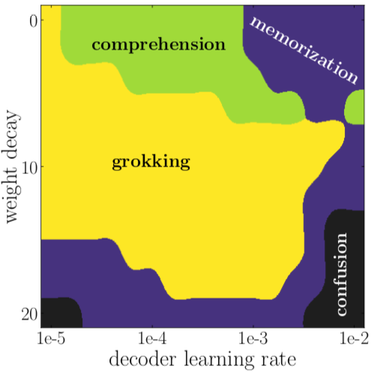
Numerical experiment: learn group operation on abstract symbols
Image of
symbol
Learning phase diagram:
Decoder
Matrix
multi-
plication
Encoder
Encoder
Image of
symbol
Image of
symbol
https://arxiv.org/abs/2205.10343
Notes:
Symbolic regression is finding a symbolic formula fitting a data table.

Slide 13


Numerical experiment: learn group operation on abstract symbols
https://arxiv.org/abs/2205.10343
Generalization coincides with emergence of structure in the representation
If decoder is too smart, you get memorization (overfitting)
If the decoded is too dumb, you get confusion
Representation learning occurs only in intermediate “Goldilocks zone”
Grokking is the phase boundary of comprehension
The Goldilocks phase is reminiscent of “intelligence from starvation” in Darwinian evolution, where resource limitations drive discovery of more efficient solutions.
Learning phase diagram:
Effective theory:
Notes:
Symbolic regression is finding a symbolic formula fitting a data table.

Slide 14
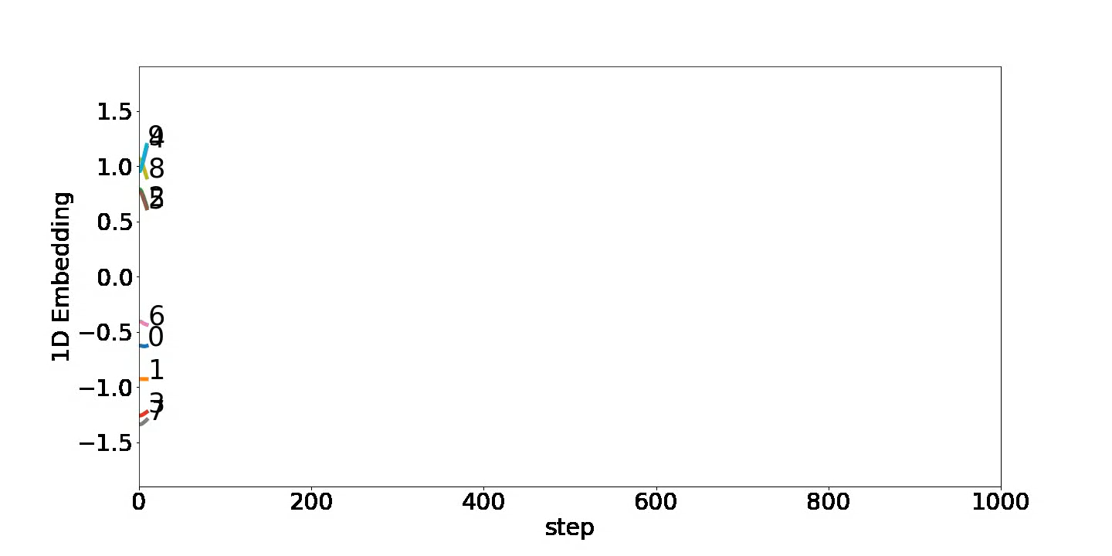
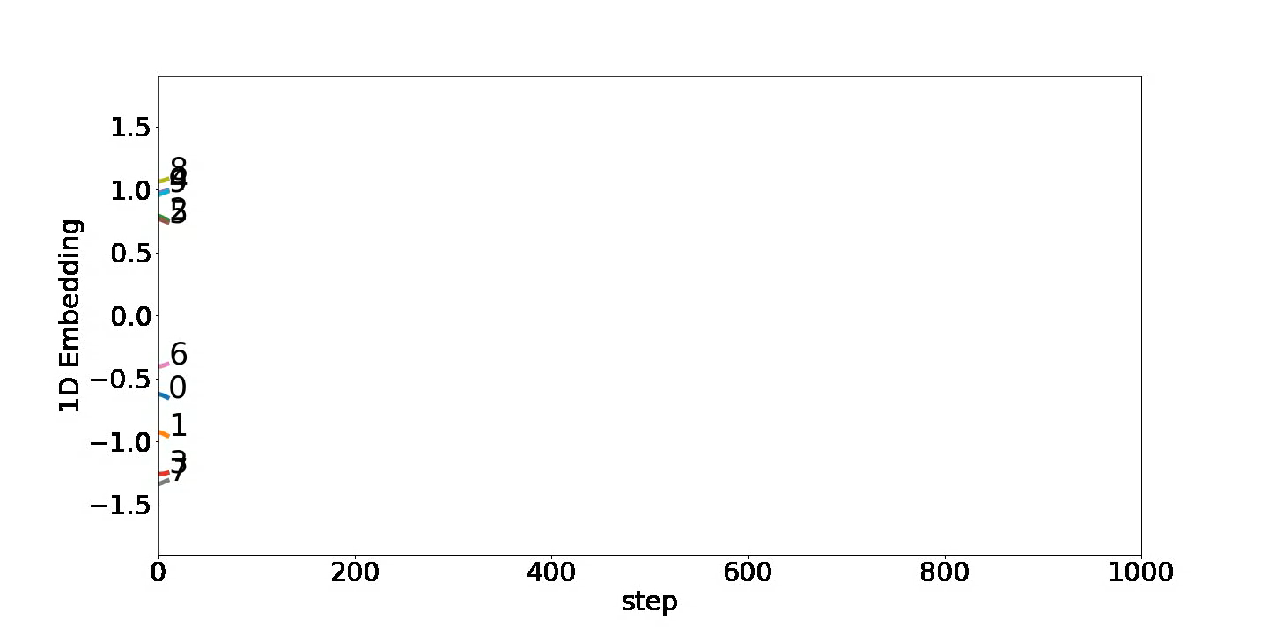
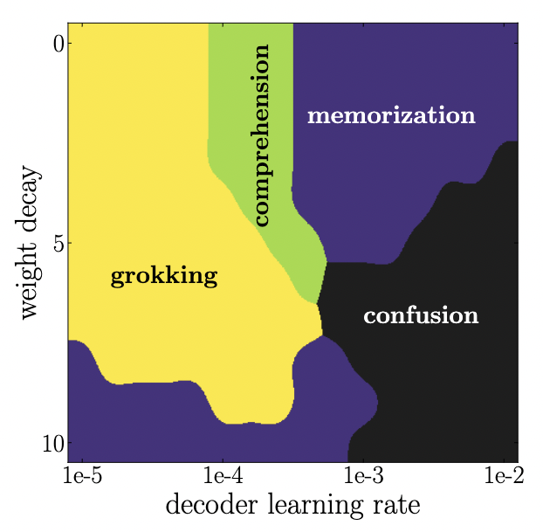
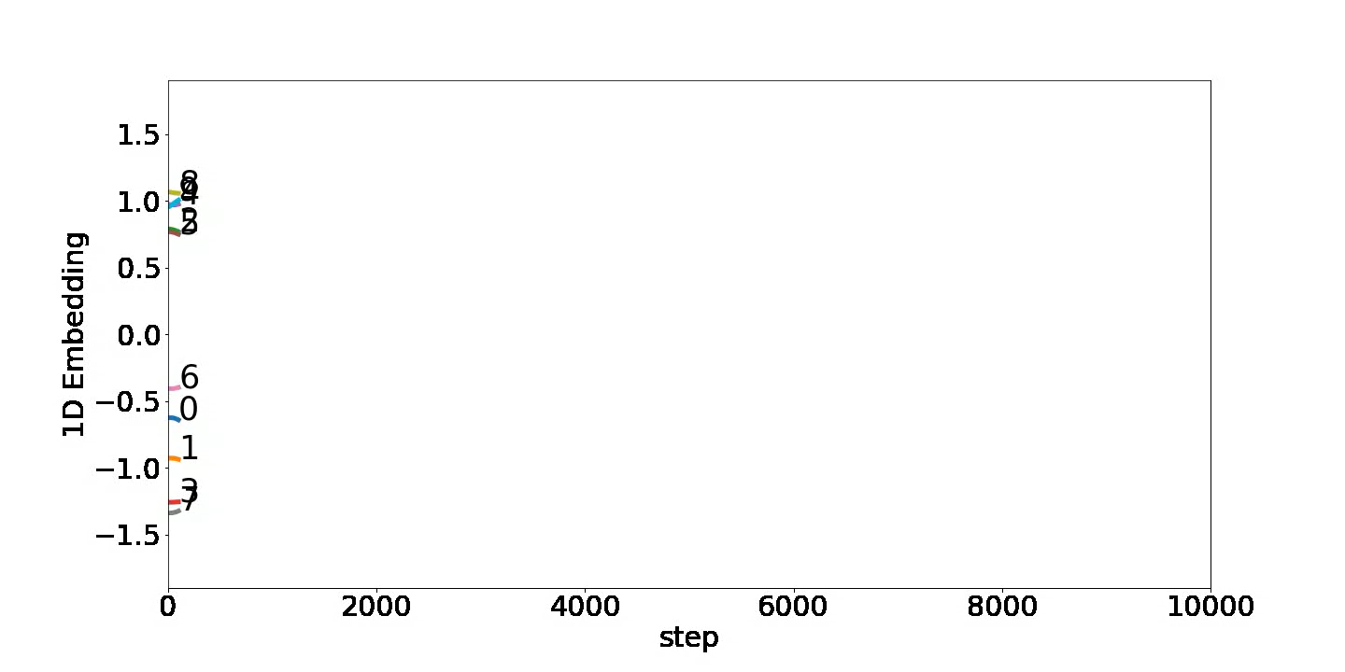


Slide 15
Beyond the black box
Data
Inscrutable
black box model
Model we can
understand
Train
neural
network
Extract
learned
knowledge
Today I'll focus on auto-discovery of
representations
equations (symbolic regression)
manifolds
useful degrees of freedom ("pregression")
conserved quantities

Slide 16
Symbolic
regression
Notes:
Just won CASP13 competition

Slide 17
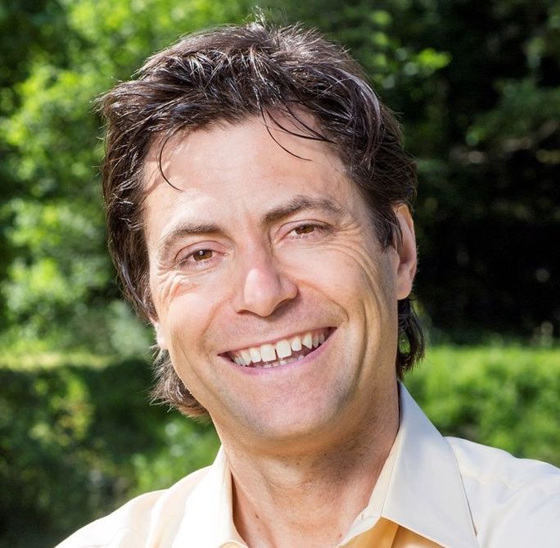
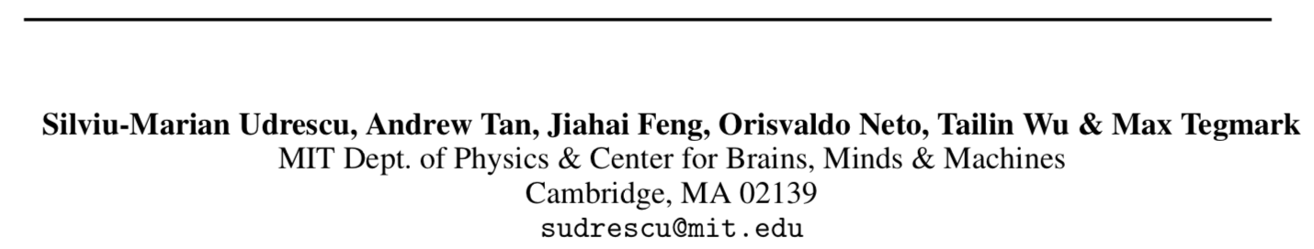
AI Feynman 2.0: Pareto-optimal symbolic regression exploiting graph modularity
(Accepted to NeurIPS 2020)
Institute for Artificial Intelligence
and Fundamental Interactions
Notes:
I'm Max Tegmark and it's a pleasure to tell you about Pareto-optimal symbolic regression exploiting graph modularity.

Slide 18
AI Feynman 2.0: Pareto-optimal symbolic regression exploiting graph modularity
What's this?
  data table
  symbolic formula
Notes:
Symbolic regression is finding a symbolic formula fitting a data table.

Slide 19
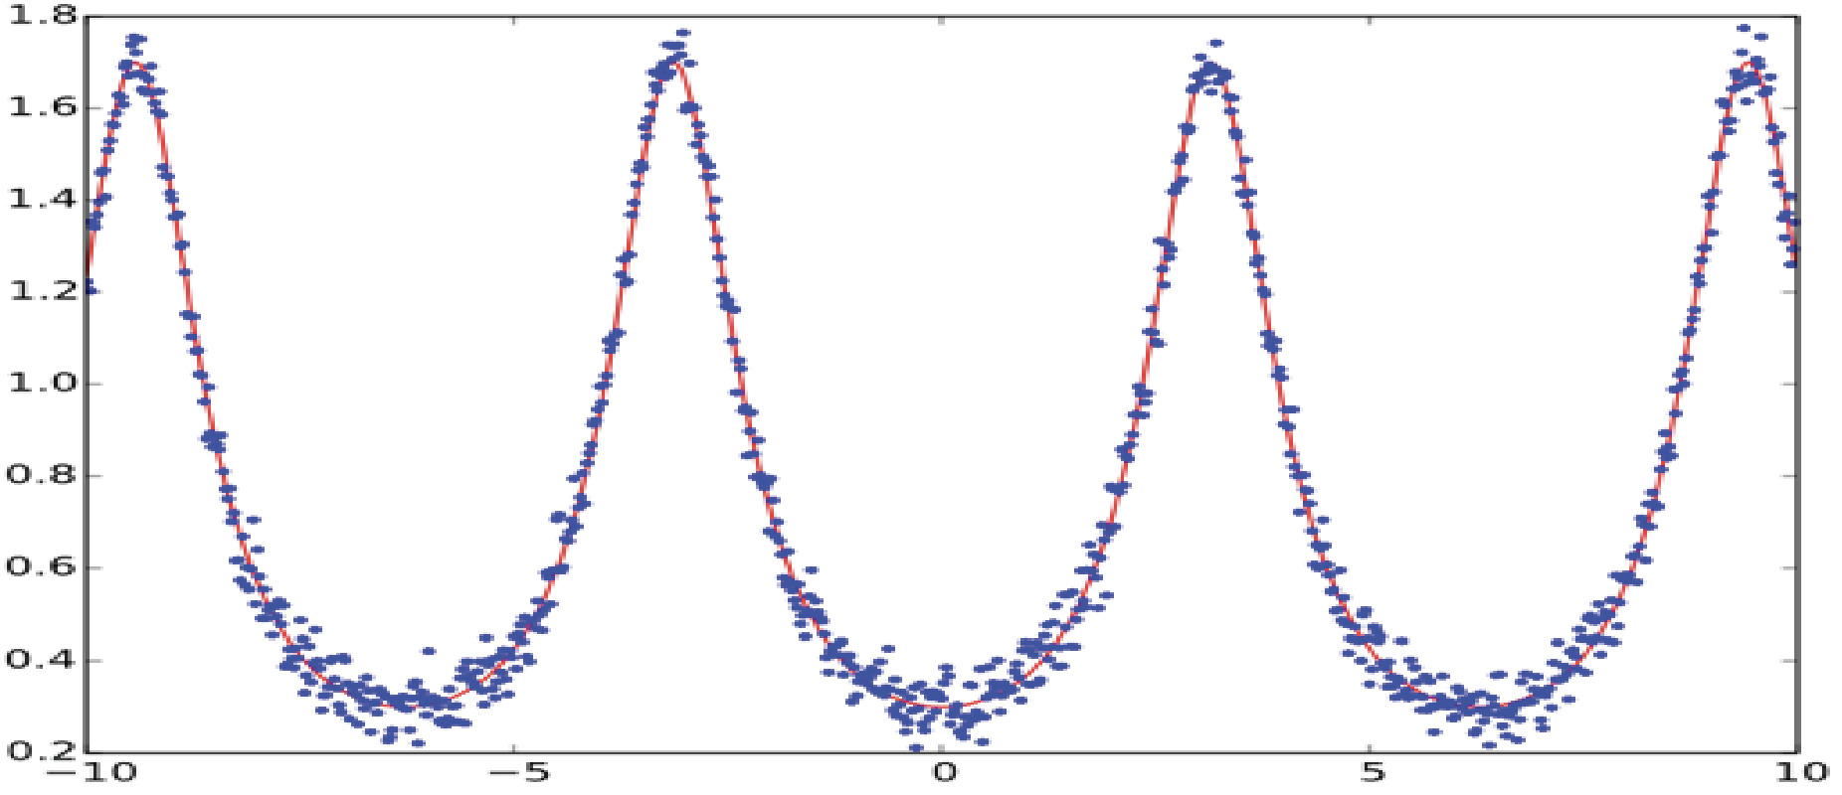
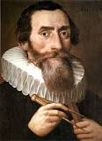
AI Feynman 2.0: Pareto-optimal symbolic regression exploiting graph modularity
What's this?
  data table
  symbolic formula
$$r=\frac{a(1−e^{2})}{1+ecos⁡(θ_{1}−θ_{2})}$$
Notes:
For example, Kepler spent 4 years doing this until he discovered that Mars moved in an ellipse, revolutionizing astronomy. Symbolic regression is widely believed to be NP-hard for generic functions.

Slide 20
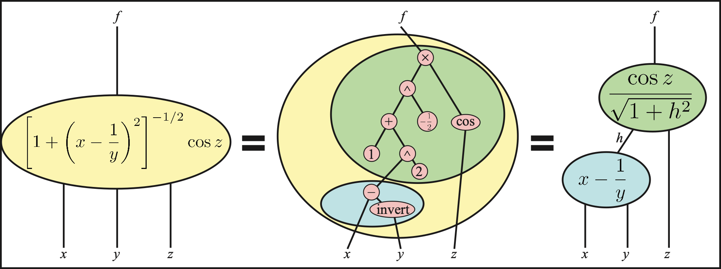
AI Feynman 2.0: Pareto-optimal symbolic regression exploiting graph modularity
What's this?
Use neural network fit to recursively discover simplifying properties & break problem into simpler ones:
Notes:
Graph modularity refers to the fact that many functions that actually appear in science have a computational graph that's modular. For example, this function of three variables can be decomposed into two functions of two variables.

Slide 21
AI Feynman 2.0: Pareto-optimal symbolic regression exploiting graph modularity
Use neural network fit to recursively discover simplifying properties & break problem into simpler ones:
Notes:
Our method discovers this modularity automatically, by training a neural network to fit the mystery function and then checking if its gradients have certain special properties. We do this recursively until...

Slide 22
AI Feynman 2.0: Pareto-optimal symbolic regression exploiting graph modularity
Use neural network fit to recursively discover simplifying properties & break problem into simpler ones:
Notes:
...modules get simple enough to solve...

Slide 23
AI Feynman 2.0: Pareto-optimal symbolic regression exploiting graph modularity
Use neural network fit to recursively discover simplifying properties & break problem into simpler ones:
Notes:
...and then combine the pieces to solve the original problem, so...

Slide 24
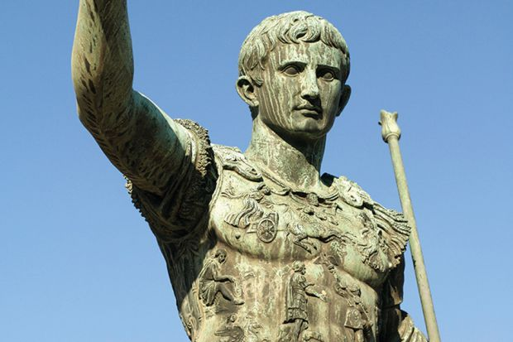
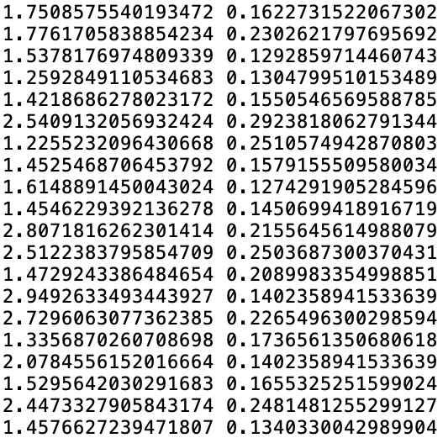
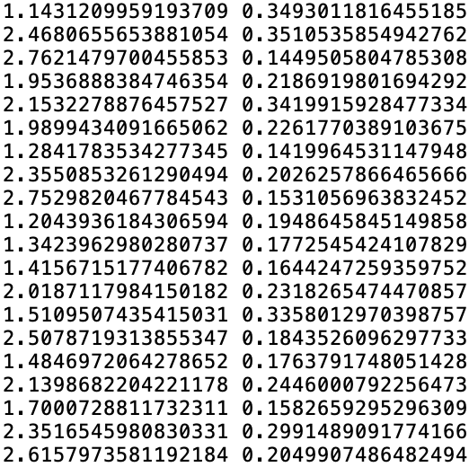
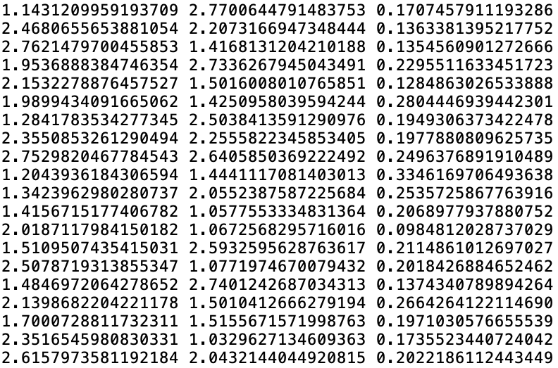
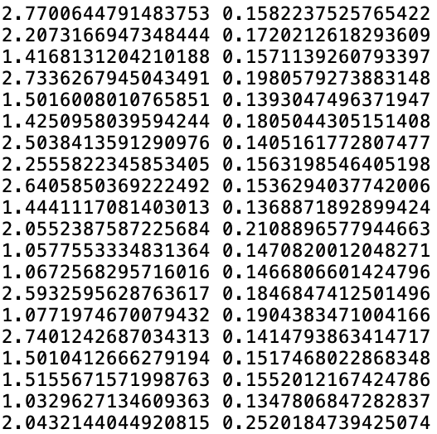
AI Feynman 2.0: Pareto-optimal symbolic regression exploiting graph modularity
Divide & conquer!
Notes:
...you can think of this as a recursive divide-and-conquer strategy of breaking the problem into simpler pieces.

Slide 25
$$\frac{Gm_{1}m_{2}}{{(x_{2}−x_{1})}^{2}+{(y_{2}−y_{1})}^{2}+{(z_{2}−z_{1})}^{2}}$$
Dimensional Analysis
$$\frac{\begin{aligned} \\ Gm_{1}^{2}\end{aligned}}{x_{1}^{2}}$$
$$\frac{\frac{m_{2}}{m_{1}}}{{(\frac{x_{2}}{x_{1}}−1)}^{2}+{(\frac{y_{2}}{x_{1}}−\frac{y_{1}}{x_{1}})}^{2}+{(\frac{z_{2}}{x_{1}}−\frac{z_{1}}{x_{1}})}^{2}}$$
$$\frac{a}{{(b−1)}^{2}+{(c−d)}^{2}+{(e−f)}^{2}}$$

Slide 26
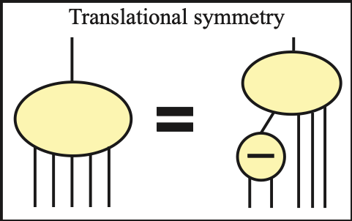
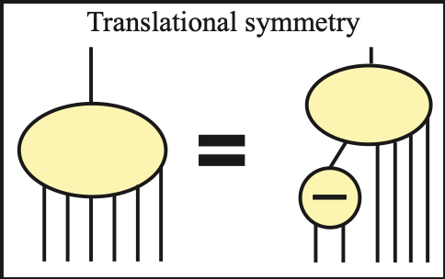
$$\frac{Gm_{1}m_{2}}{{(x_{2}−x_{1})}^{2}+{(y_{2}−y_{1})}^{2}+{(z_{2}−z_{1})}^{2}}$$
Dimensional Analysis
$$\frac{\begin{aligned} \\ Gm_{1}^{2}\end{aligned}}{x_{1}^{2}}$$
$$\frac{\frac{m_{2}}{m_{1}}}{{(\frac{x_{2}}{x_{1}}−1)}^{2}+{(\frac{y_{2}}{x_{1}}−\frac{y_{1}}{x_{1}})}^{2}+{(\frac{z_{2}}{x_{1}}−\frac{z_{1}}{x_{1}})}^{2}}$$
$$\frac{a}{{(b−1)}^{2}+{(c−d)}^{2}+{(e−f)}^{2}}$$
Translational Symmetry (e-f $→h$)
Translational Symmetry (c-d $→$g)
$$\frac{a}{{(b−1)}^{2}+g^{2}+h^{2}}$$
$$\frac{a}{{(b−1)}^{2}+g^{2}+{(e−f)}^{2}}$$
h
g
e
c
d
f

Slide 27
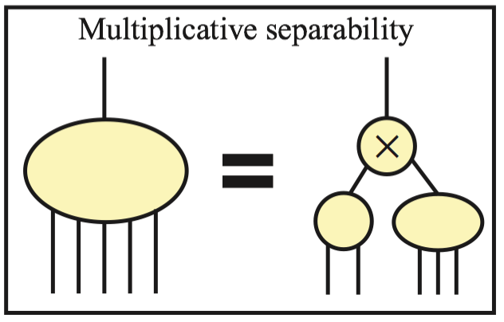
$$\frac{Gm_{1}m_{2}}{{(x_{2}−x_{1})}^{2}+{(y_{2}−y_{1})}^{2}+{(z_{2}−z_{1})}^{2}}$$
Dimensional Analysis
$$\frac{\begin{aligned} \\ Gm_{1}^{2}\end{aligned}}{x_{1}^{2}}$$
$$\frac{\frac{m_{2}}{m_{1}}}{{(\frac{x_{2}}{x_{1}}−1)}^{2}+{(\frac{y_{2}}{x_{1}}−\frac{y_{1}}{x_{1}})}^{2}+{(\frac{z_{2}}{x_{1}}−\frac{z_{1}}{x_{1}})}^{2}}$$
$$\frac{a}{{(b−1)}^{2}+{(c−d)}^{2}+{(e−f)}^{2}}$$
Translational Symmetry (c-d $→$g)
$$a$$
Translational Symmetry (e-f $→h$)
$$\frac{a}{{(b−1)}^{2}+g^{2}+h^{2}}$$
$$\frac{a}{{(b−1)}^{2}+g^{2}+{(e−f)}^{2}}$$
$$\frac{1}{{(b−1)}^{2}+g^{2}+h^{2}}$$

Slide 28
$$\frac{Gm_{1}m_{2}}{{(x_{2}−x_{1})}^{2}+{(y_{2}−y_{1})}^{2}+{(z_{2}−z_{1})}^{2}}$$
Dimensional Analysis
$$\frac{\begin{aligned} \\ Gm_{1}^{2}\end{aligned}}{x_{1}^{2}}$$
$$\frac{\frac{m_{2}}{m_{1}}}{{(\frac{x_{2}}{x_{1}}−1)}^{2}+{(\frac{y_{2}}{x_{1}}−\frac{y_{1}}{x_{1}})}^{2}+{(\frac{z_{2}}{x_{1}}−\frac{z_{1}}{x_{1}})}^{2}}$$
$$\frac{a}{{(b−1)}^{2}+{(c−d)}^{2}+{(e−f)}^{2}}$$
Translational Symmetry (c-d $→$g)
$$a$$
Translational Symmetry (e-f $→h$)
Multiplicative Separability
$$\frac{a}{{(b−1)}^{2}+g^{2}+h^{2}}$$
$$\frac{a}{{(b−1)}^{2}+g^{2}+{(e−f)}^{2}}$$
$$\frac{1}{{(b−1)}^{2}+g^{2}+h^{2}}$$
$${(b−1)}^{2}+g^{2}+h^{2}$$

Slide 29
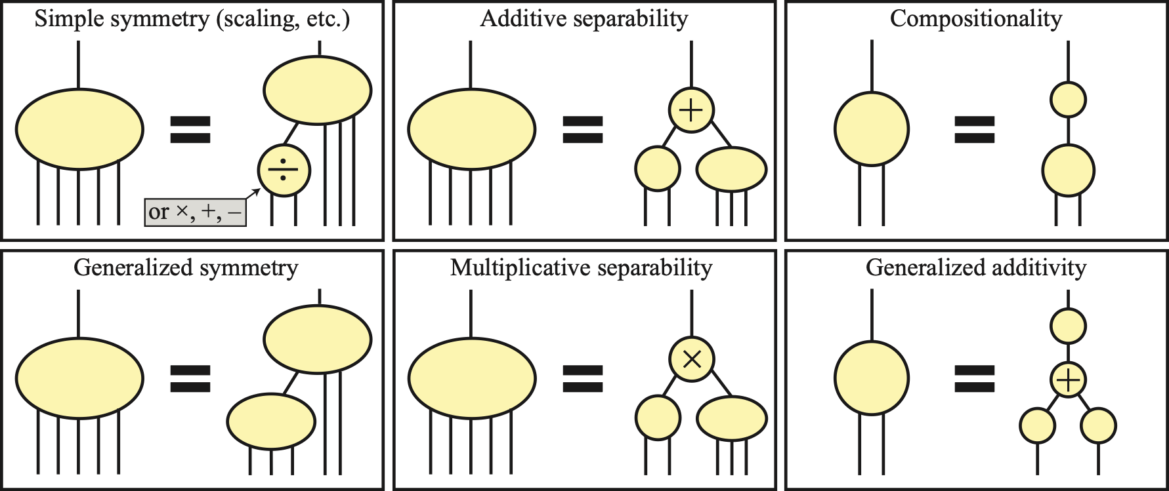
AI Feynman 2.0: Pareto-optimal symbolic regression exploiting graph modularity
Notes:
Our earlier work auto-discovered merely some special cases, but our new method has the potential to discover any graph modularity involving any functions of any number of variables.

Slide 30
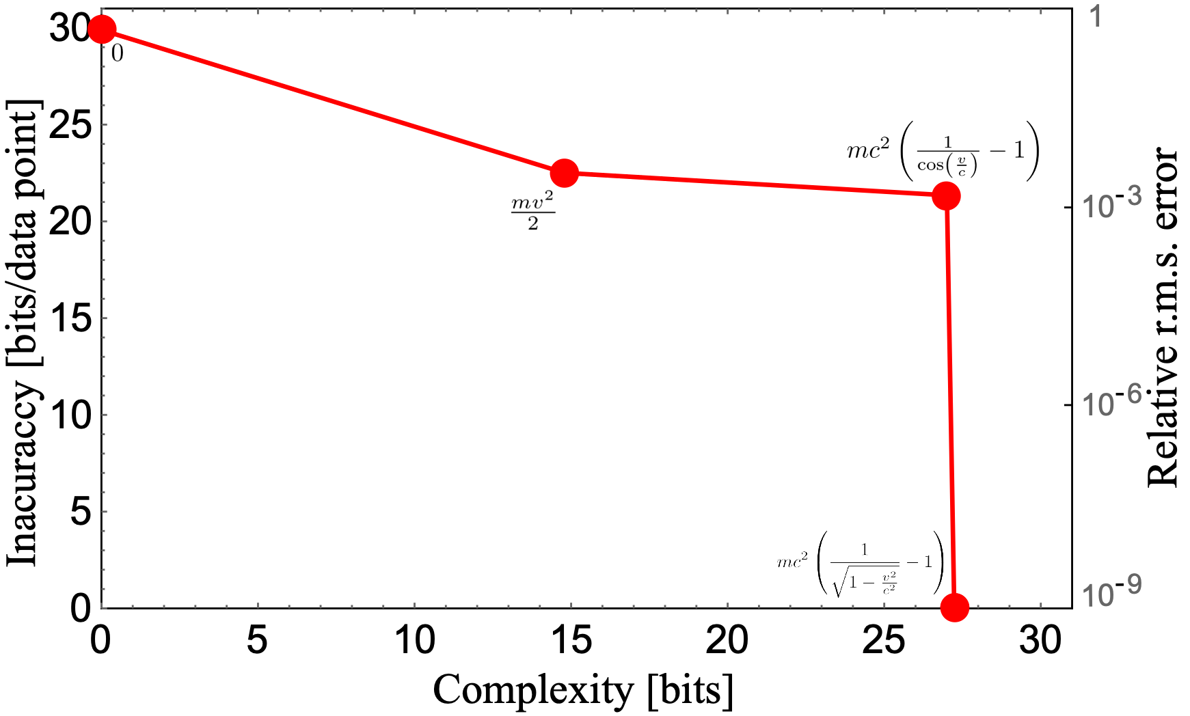
AI Feynman 2.0: Pareto-optimal symbolic regression exploiting graph modularity
What's this?
Notes:
I'm Silviu-Marian Udrescu. Pareto-optimal refers to the fact that we evaluate not only the inaccuracy of each formula, but also its complexity, and keep only the simplest formulas for each accuracy level. Here you see how we auto-discovered not only...

Slide 31
AI Feynman 2.0: Pareto-optimal symbolic regression exploiting graph modularity
Notes:
the relativistic kinetic energy formula, but also...

Slide 32
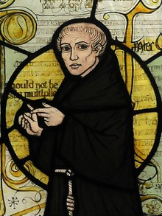
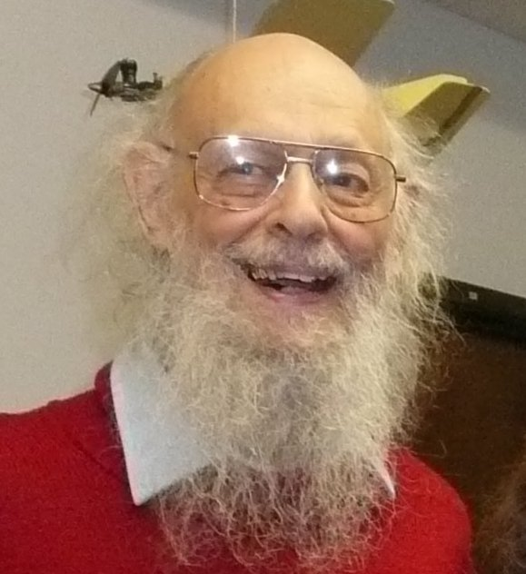
AI Feynman 2.0: Pareto-optimal symbolic regression exploiting graph modularity
William of Occam
Ray Solomonoff
Notes:
the classical approximation m-v-squared over two.

Slide 33
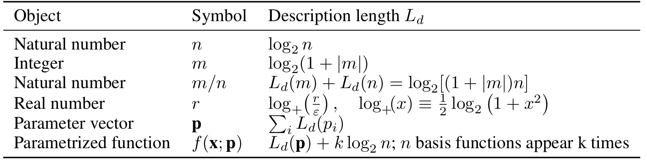
Complexity definitions:
William of Occam:
too vague to code up
Our compromise:
quantitative & fast to compute
Ray Solomonoff:
rigoroius but
too hard to compute
Notes:
We measured the complexity in bits of information, using an easy-to-compute compromise between Occam's razor and Solomonoff's algorithmic complexity.

Slide 34
Benchmarks for numerical experiments:
100 most famous/complicated equations from Feynman Lectures on Physics
Examples:
$$f=\frac{e^{−\frac{{\left(x−μ\right)}^{2}}{2σ^{2}}}}{\sqrt{2πσ^{2}}}$$
$$m=\frac{m_{0}}{\sqrt{1−\frac{v^{2}}{c^{2}}}}$$
$$K=\frac{1}{2}m\left(v^{2}+u^{2}+w^{2}\right)$$
$$E=\frac{3}{4πε}\frac{pz}{r^{5}}\sqrt{x^{2}+y^{2}}$$
$$F=\frac{Gm_{1}m_{2}}{{\left(x_{1}−x_{2}\right)}^{2}+{\left(y_{1}−y_{2}\right)}^{2}+{\left(z_{1}−z_{2}\right)}^{2}}$$
$$r=\frac{m_{1}r_{1}+m_{2}r_{2}}{m_{1}+m_{2}}$$
$$L=mrv\sin{θ}$$
$$P=\frac{pE}{ℏ}\frac{\sin{{\left(\frac{\left(ω−ω_{0}\right)t}{2}\right)}^{2}}}{{\left(\frac{\left(ω−ω_{0}\right)}{2}\right)}^{2}}$$
$$x=\sqrt{x_{1}^{2}+x_{2}^{2}−2x_{1}x_{2}cos⁡(θ_{1}−θ_{2})}$$
$$E=2U(1−\cos{kd})$$
$$P=\frac{nk_{b}T}{V}$$
$$L=\frac{ℏω^{3}}{π^{2}c^{2}(e^{ℏω/k_{b}T}−1)}$$
$$P=\frac{nα}{1−\frac{nα}{3}}εE$$
$$x=x_{1}(\cos\left(ωt\right)+α{\cos\left(ωt\right)}^{2})$$
Notes:
So how well does our AI Feynman algorithm work? We tested it on data tables from four sets of equations. We took 100 of the most famous equations from the Feynman Lectures on physics, ...

Slide 35
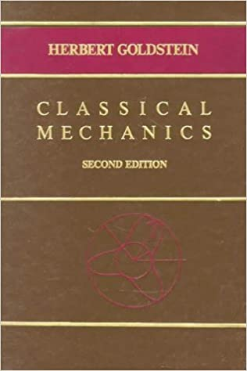
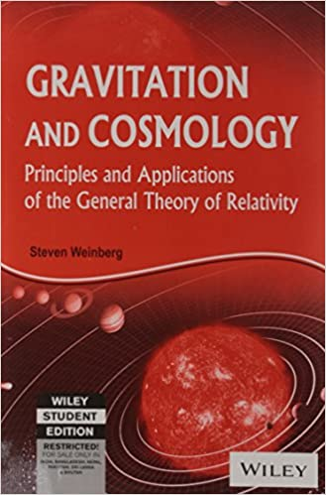
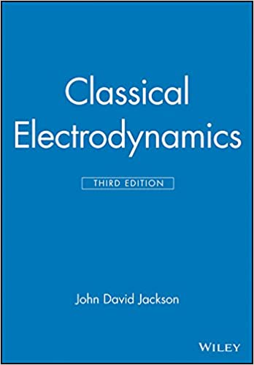
Benchmarks for numerical experiments:
100 most famous/complicated equations from Feynman Lectures on Physics
20 harder equations from graduate physics books
$$\frac{dσ}{dΩ}={\left(\frac{Z_{1}Z_{2}αℏc}{4E\sin^{2}{\frac{θ}{2}}}\right)}^{2}$$
$$\frac{dσ}{d\cos{θ}}=\frac{πα^{2}ℏ^{2}}{m^{2}c^{2}}{\left(\frac{ω^{′}}{ω}\right)}^{2}\left(\frac{ω^{′}}{ω}+\frac{ω}{ω^{′}}−\sin^{2}{θ}\right)$$
$$θ_{0}=\arccos\left(\frac{\cos{θ_{s}}−\frac{v}{c}}{1−\frac{v}{c}\cos{θ_{s}}}\right)$$
$$\frac{1}{r}=\frac{mk}{L^{2}}\left(1+\sqrt{1+\frac{2EL^{2}}{mk^{2}}}\cos\left(θ_{1}−θ_{2}\right)\right)$$
$$t=\frac{2πa^{\frac{3}{2}}}{\sqrt{G(m_{1}+m_{2})}}$$
$$ρ_{0}=−\frac{1}{8πG}\left[\frac{k}{R_{0}^{2}}+H_{0}^{2}\left(1−2q_{0}\right)\right]$$
$$I=I_{0}{{\left(\frac{\sin\left(\frac{φ}{2}\right)}{\frac{φ}{2}}\frac{\sin\left(\frac{Nδ}{2}\right)}{\sin\left(\frac{δ}{2}\right)}\right)}^{2}}^{}$$
$$P=−\frac{\frac{32}{5}G^{4}}{c^{5}}\frac{{\left(m_{1}m_{2}\right)}^{2}(m_{1}+m_{2})}{r^{5}}$$
$$H=\sqrt{{\left(p−qA\right)}^{2}c^{2}+m^{2}c^{4}}+qV$$
$$ω^{′}=\frac{\sqrt{1−\frac{v^{2}}{c^{2}}}ω}{1+\frac{v}{c}\cos{θ}}$$
$$v=\sqrt{\frac{2}{m}\left(E−V−\frac{L^{2}}{2mr^{2}}\right)}$$
$$r=\frac{a(1−e^{2})}{1+ecos⁡(θ_{1}−θ_{2})}$$
$$V=E\cos{θ\left(−r+\frac{ε−1}{ε+2}\frac{a^{3}}{r^{2}}\right)}$$
Notes:
...20 harder equations from graduate physics textbooks, ...

Slide 36
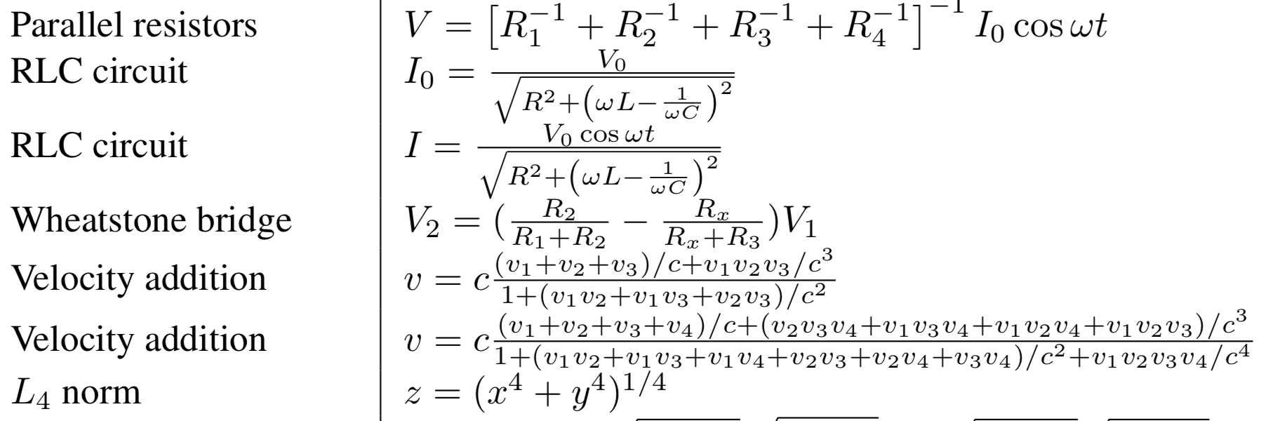
Benchmarks for numerical experiments:
100 most famous/complicated equations from Feynman Lectures on Physics
20 harder equations from graduate physics books
12 harder equations with generalized modularity
Examples:
Generalized symmetry,
separability
Generalized symmetry,
separability
Generalized symmetry,
separability
Generalized symmetry, scaling symmetry,
separability
Generalized symmetry
Compositionality,
generalized additivity
Generalized symmetry
Notes:
...12 equations with generalized modularity...

Slide 37

Benchmarks for numerical experiments:
100 most famous/complicated equations from Feynman Lectures on Physics
20 harder equations from graduate physics books
12 harder equations with generalized modularity
10 probability distributions whose samples were converted to density estimates using normalizing flows
Notes:
...and ten probability distributions whose samples were converted to density estimates using normalizing flows.

Slide 38
 | Feynman Database for Symbolic Regression, basic 100 | Feynman Database for Symbolic Regression, harder 20 | 12 modular equations | 10 probability distributions
Schmidt & Lipson 2009 | 71% | 15% | 42% | 60%
Udrescu & Tegmark 2020 | 100% | 85% | 42% | 70%
This paper | 100% | 90% | 100% | 80%
Notes:
As you can see, we solve the vast majority of the mysteries and achieve state-of-the-art performance.

Slide 39

 | Feynman Database for Symbolic Regression, basic 100 | Feynman Database for Symbolic Regression, harder 20 | 12 modular equations | 10 probability distributions
Schmidt & Lipson 2009 | 71% | 15% | 42% | 60%
Udrescu & Tegmark 2020 | 100% | 85% | 42% | 70%
This paper | 100% | 90% | 100% | 80%
Notes:
We also found that our MDL-inspired Pareto frontier approach made things orders of magnitude more robust to noise than our previous work.

Slide 40

How you
can use
this:
pip install aifeynman
Please email us about
collaborating on analyzing your data or generalizing this to other domains!
tegmark@mit.edu
https://ai-feynman.readthedocs.io/en/latest/
Notes:
The three-word summary of this talk is "pip install aifeynman", which is all you need to type to install our code on your computer. We'd love to collaborate on analyzing your datasets or on generalizing this to other domains!

Slide 41

State of field over past decade:
Schmidt Lipson Eureqa! algorithm best
Many generic algorithms
Criticism of field for lack of benchmarks
Notes:
Just won CASP13 competition

Slide 42

https://space.mit.edu/home/tegmark/aifeynman.html
Notes:
Just won CASP13 competition

Slide 43
Our focus: Intelligible Intelligence
Data
Inscrutable
black box model
Model we can
understand
Neural
network
Our
focus
Today I'll discuss auto-discovery of
equations (symbolic regression)
useful degrees of freedom ("pregression")
conserved quantities

Slide 44
Manifold
learning
Notes:
Just won CASP13 competition

Slide 45


https://arxiv.org/abs/2109.09721

Slide 46

https://arxiv.org/abs/2109.09721

Slide 47




What happens inside black holes?
https://arxiv.org/abs/2109.09721
You die!
Not right away! die
Schwarzschild 1915
Gullstrand & Painlevé 1932

Slide 48
Pregression
Notes:
Just won CASP13 competition

Slide 49


arXiv:2005.11212
Silviu Marian-Udrescu

Slide 50

Cheating!
(Also Schmidt & Lipson 2009, Science, 324, 81)

Slide 51
Symbolic "pregression":
auto-discovering the relevant variables too

Slide 52


Slide 53

Harder
than you
might think!

Slide 54



Slide 55
William of Occam
How define simple?

Slide 56



How define simple?

Slide 57



Slide 58


No acceleration in physical space
Latent space – oops!

Slide 59


Which affine transformation
of this space makes the equations of motion maximally simple?

Slide 60
Can ML discover new physics not put in by hand?
Can ML discover new physics equations not put in by hand?
Yes!
Can ML discover inertial frames not put in by hand?
Yes!

Slide 61
Our focus: Intelligible Intelligence
Data
Inscrutable
black box model
Model we can
understand
Neural
network
Our
focus
Today I'll discuss auto-discovery of
equations (symbolic regression)
useful degrees of freedom ("pregression")
conserved quantities

Slide 62
Conserved
quantities
Notes:
Just won CASP13 competition

Slide 63


Ziming Liu

Slide 64


Double pendulum (n = 4)
d = 2
c = 2
d = 3
c = 1
d = 1
c = 3
d = 3
c = 1
c = n – d
c = # of conserved quantities
n = phase space dimensionality
d = state manifold dimensionality

Slide 65

c = n – d
c = # of conserved quantities
n = of phase space dimensionality
d = state manifold dimensionality

Slide 66


Slide 67



Slide 69


Slide 70





Slide 71


Double pendulum

Slide 72


Slide 73

Manifold: $N_{eff}\left(M\right)=\sum_{i}{I\left(λ_{i}>\frac{θ}{n}\right)},n:totaldimension,θ=0.1$
Conservation $N_{eff}(C)=n−N_{eff}(M)$
$$F\left(r\right)=\frac{A}{r^{2+ε}}$$
$$εt=1$$

Slide 74

Manifold: $N_{eff}\left(M\right)=\sum_{i}{I\left(λ_{i}>\frac{θ}{n}\right)},n:totaldimension,θ=0.1$
Conservation $N_{eff}(C)=n−N_{eff}(M)$
$$H=\frac{1}{2}{\overset{˙}{ρ}}^{2}+\frac{1}{2}ρ^{2}+\frac{1}{2}{\overset{˙}{z}}^{2}+\frac{1}{2}z^{2}+kρ^{2}z^{2}$$
$$A_{ρ}^{2}k=1$$
Note: Amount of time is fixed.
$A_{ρ}$: amplitude in $ρ$ direction

Slide 75


Slide 76



Slide 77
Summary
Notes:
Just won CASP13 competition

Slide 78

{
Unknown truth
produces data
Continuous: Embed discrete symbols & parameters in R^{n}
Dimensional: Add parameters to avoid topological problems
Relaxation
Traditional ML
Inscrutable
black box model
Discover & enforce dimensionality reduction
Discover & enforce modularity
Discover & enforce symmetries
Discover & enforce discreteness
Discover & enforce clever representations
Discover & enforce normal form
Simplification
Interpretable (by humans)
Verifiable (by algorithms)
Boundable
More intelligible model
Notes:
ML beats symb for *learning*, but Alexander principle obfuscates simplicity.
Relaxation to continuous overcomplete rep => almost all solutions messy.
Do 1) relaxation + 2) simplification

Slide 79
Notes:
Just won CASP13 competition

Slide 80
Notes:
Just won CASP13 competition

Slide 81




Summary:
Pregression
AI Feynman
Got fun data we can
try this on?

Slide 82
Optimal data compression
Notes:
Just won CASP13 competition

Slide 84



Slide 85


Slide 86

(Remember Tishby's IB talk!)

Slide 87

Most useful compressions correspond to phase
transitions!

